Slide 1

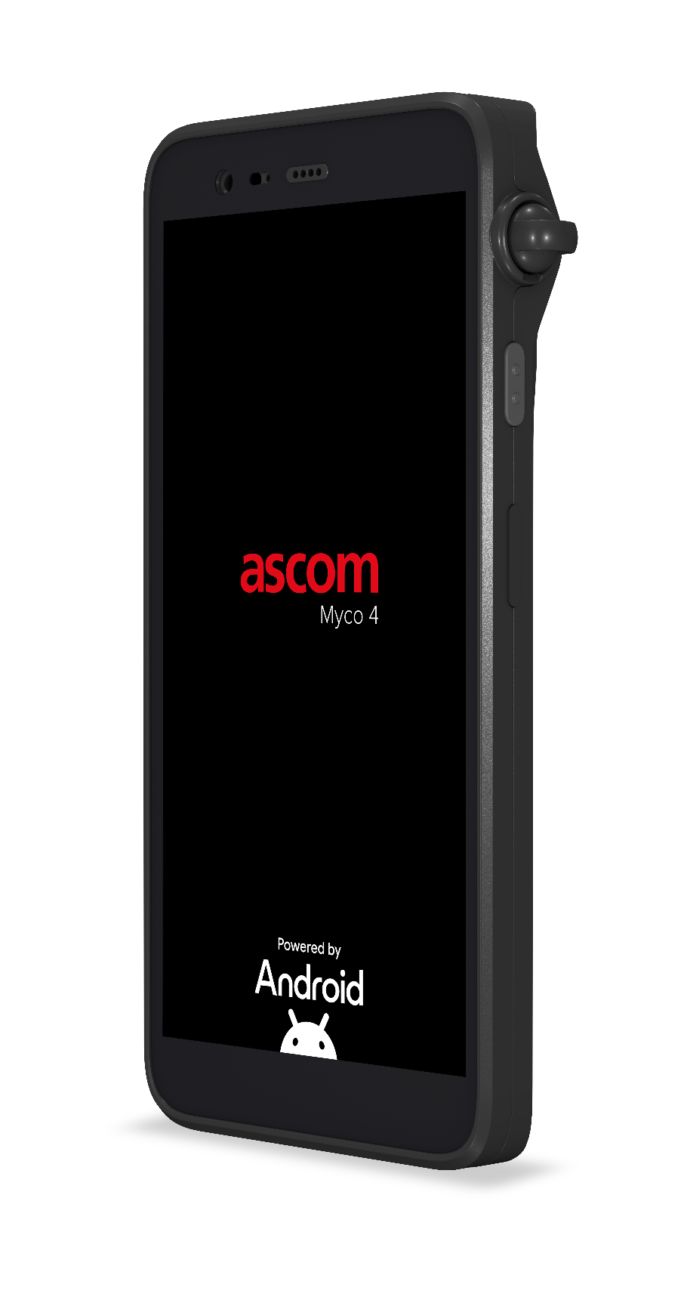
Ascom Myco 4
The perfect smartphone for integration with the Ascom solutions
APRIL 2025 FOR EXTERNAL USE

Slide 2
Disclaimer
This document contains forward-looking statements and conceptual pictures of technologies and functions which may not be available in current Ascom products. No assumptions are implied, nor should any assumptions be made as to the future availability of these or other technologies and functions. Ascom assumes no responsibility to update forward-looking statements or adapt them to future events or developments.
Features and functions described may require additional software from Ascom or third parties to realize. This document is confidential and for the purpose of informational presentation to a specific audience. All materials here are copyright © Ascom unless otherwise stated, and may not be copied, distributed or reproduced in whole or in part, nor passed to any third party without permission from Ascom. Availability of any future designs or products are subject to regulatory clearance. Products may not be available in a particular country or region.

Slide 3

Agenda
Ascom Myco 4 – Sales Deck
Welcome and introductions
Challenges
Problems we solve
How we can help you
Myco 4 features
Q&A

Slide 4

Welcome and introductions
Ascom Myco 4

Slide 5

Challenges

Slide 6

Common challenges
High technology spend and still lack of effective and efficient communication
Professional workers face the daily risk of physical violence or harassment in the workplace
Unable to reach team members and communicate quickly in response to unplanned events
Staff members are unnecessarily interrupted in their tasks when not knowing who is calling

Slide 7

Problems we solve
Improving end-to-end communication

Slide 8
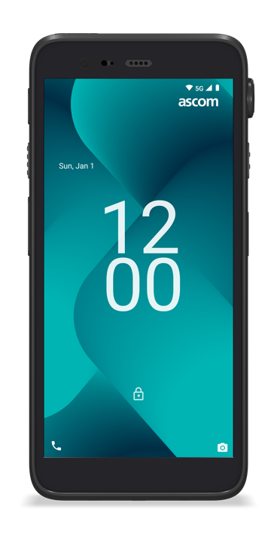

Lowering total cost of ownership
A single professional grade device that fulfills the
use cases of several work devices
A shareable device that reduces capital expenditures
Durable and robust – can help with fewer repairs and replacements over much longer life than traditional smartphones
Ultimately increases opportunity to recoup ROI

Slide 9
Maximizing productivity with a dependable work tool
Built to withstand even the toughest working environments
Maximizing workflow continuity without disruption
– long battery life with hot swap
Compliant to present-day disinfection protocols
Notes:
Shut down or reboot
Shareable and secure — preserves information security as application data is automatically wiped whenever user logs out or Myco 4 is docked in charger.

Slide 10
Enabling mission-critical communications
Highly optimized wireless technology to ensure consistent connectivity, even on the move
Together with Ascom applications, provides smart
alert notifications that comply with IEC ¹ medical
alarming standards
Supports Federal Information Processing Standards
(FIPS 140-3)
Automatically logs out user in compatible apps and wipes the call log when docked to safeguard patient information
Different profiles for different behavior in different chargers, e.g. silent in rack storage and loud ring
signal in on-duty sleeping room
Reads out who is calling and listens to commands to accept or reject call
1 IEC 60601-1-8 Medical electrical equipment - Part 1-8: General requirements for basic safety and essential performance - Collateral Standard: General requirements, tests and guidance for alarm systems in medical electrical equipment and medical electrical systems“
Notes:
Smart at-a-glance notifications (color, sound, rhythm and vibrations) and this parallels alarming standards
IEC 60601-1-8:2006 Medical electrical equipment — Part 1-8: General requirements for basic safety and essential performance — Collateral standard: General requirements, tests and guidance for alarm systems in medical electrical equipment and medical electrical systems
Aligns with nurse call dome lights notifications

Slide 11
Operates in public and private 5G networks
Designed use in all types of 5G networks:
Public 5G
Sliced 5G
Private 5G
Non-Stand Alone (NSA)
Stand Alone (SA)
Tested with some of the major suppliers
of 5G equipment
Native SIP client adds voice capabilities to
private 5G networks
Ability to control if a (private) 5G network shall be prioritized over Wi-Fi
Notes:
Ericsson and Nokia 5G equipment have been tested.
It is very expensive to add a 5G voice in a private network. Using the native SIP client on Ascom Myco 4 together with a SIP PBX is a cost-effective solution for voice in a private 5G network.

Slide 12

How we can help you
What sets the Myco 4 apart

Slide 13

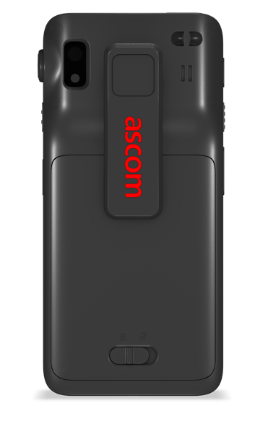



Building tomorrow’s solutions today
Ascom Myco 4 is globally certified
Google recommended
Google verified
Supports Federal Information Processing Standards
(FIPS 140-3)
Meets or exceeds Google’s strict enterprise requirements
Wi-Fi Alliance certified, Voice-Enterprise application and services

Slide 14
















Mutually certified interoperability with Ascom technology partners
Building tomorrow’s solutions today together with our technology partners
On top of robust and open technology standards
as a baseline, Ascom has an ecosystem of industry-leading technology partners that integrate, validate and certify Myco 4 for interoperability across the full IT stack of systems.
Ascom’s technology partnerships and interoperability program continues to grow.
Medical Device
EMR/EHR
Mobility
apps
EMM and ICT security
Workspace ONE
PBX and UC
Wi-Fi
Private 5G

Slide 15
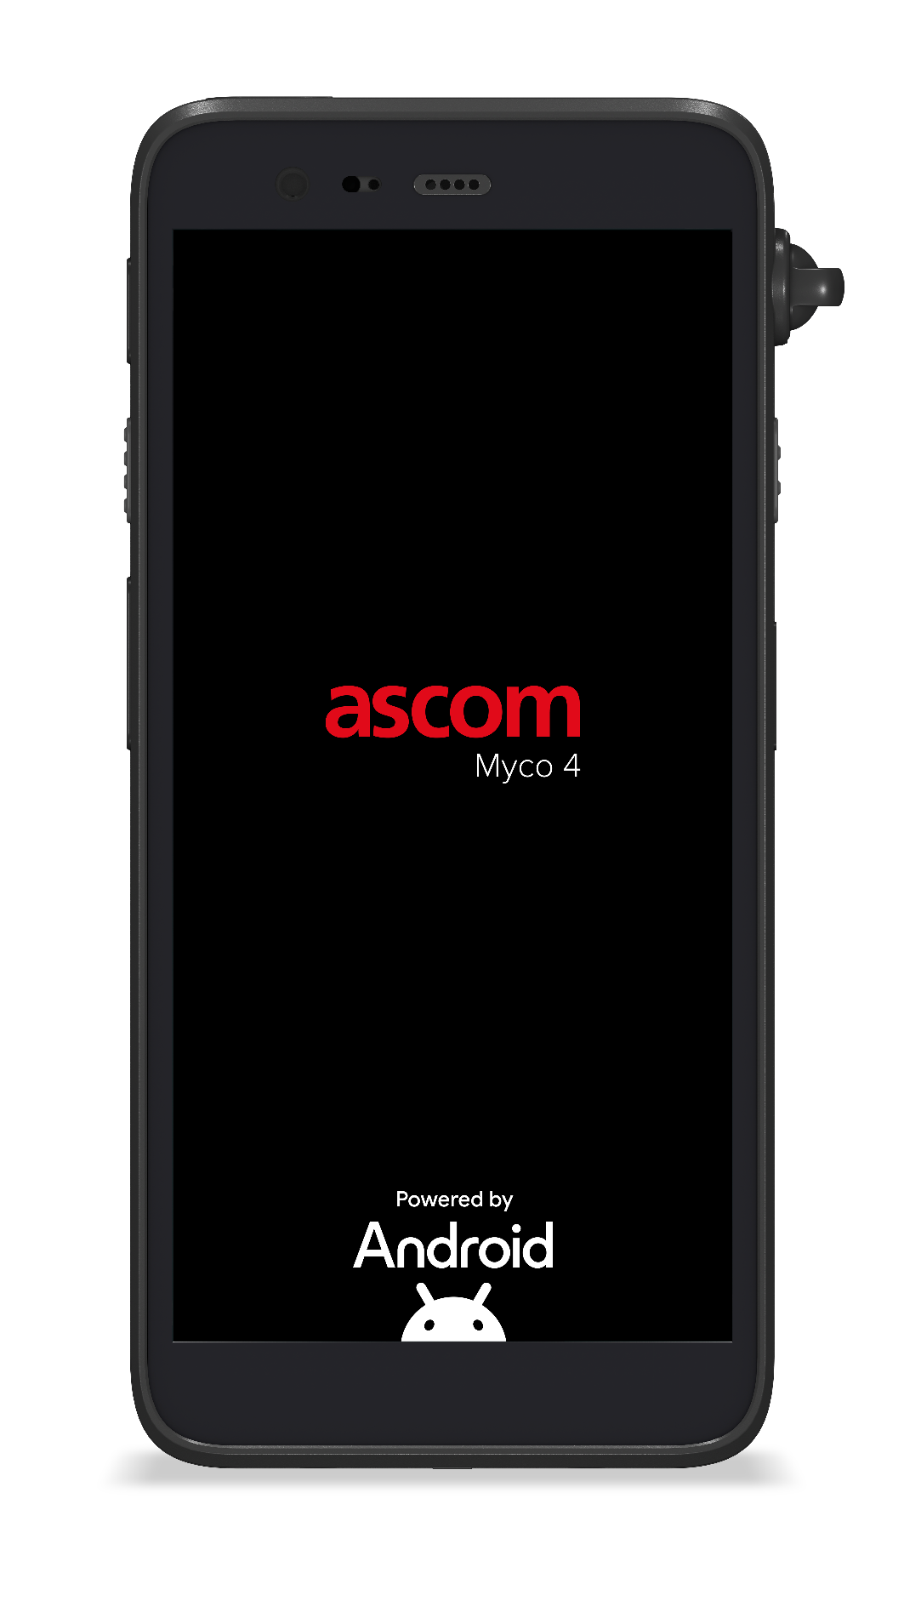


Ascom Myco 4 – DECT enabled
The best of both worlds
Remarkable voice quality and consistent performance
Wideband audio support – delivers enriched high-definition
speech quality.
Using dedicated frequency bands, DECT delivers reliable
wireless network performance - free of interference from other
radio technologies.
  Ascom Myco 4 combines the best attributes of DECT and Wi-Fi for unparalleled performance,
  reliability, and user experience.
Enterprise-grade Wi-Fi 6E performance
Enables reliable connectivity to enterprise LAN infrastructure,
giving access to information resources, applications, and services e.g., EMR, Lab, critical alerting, care team collaboration, e-mail, etc.
Access an entire eco-system of Android™ Apps on Google Play.
Notes:
* In US – DECT uses 1920- 1930MHz frequency allocation, also known as UPCS band. NOTE: this allocation is not technology exclusive, but is, in practice, "clean" enough to achieve similar interference-free operation.

Slide 16

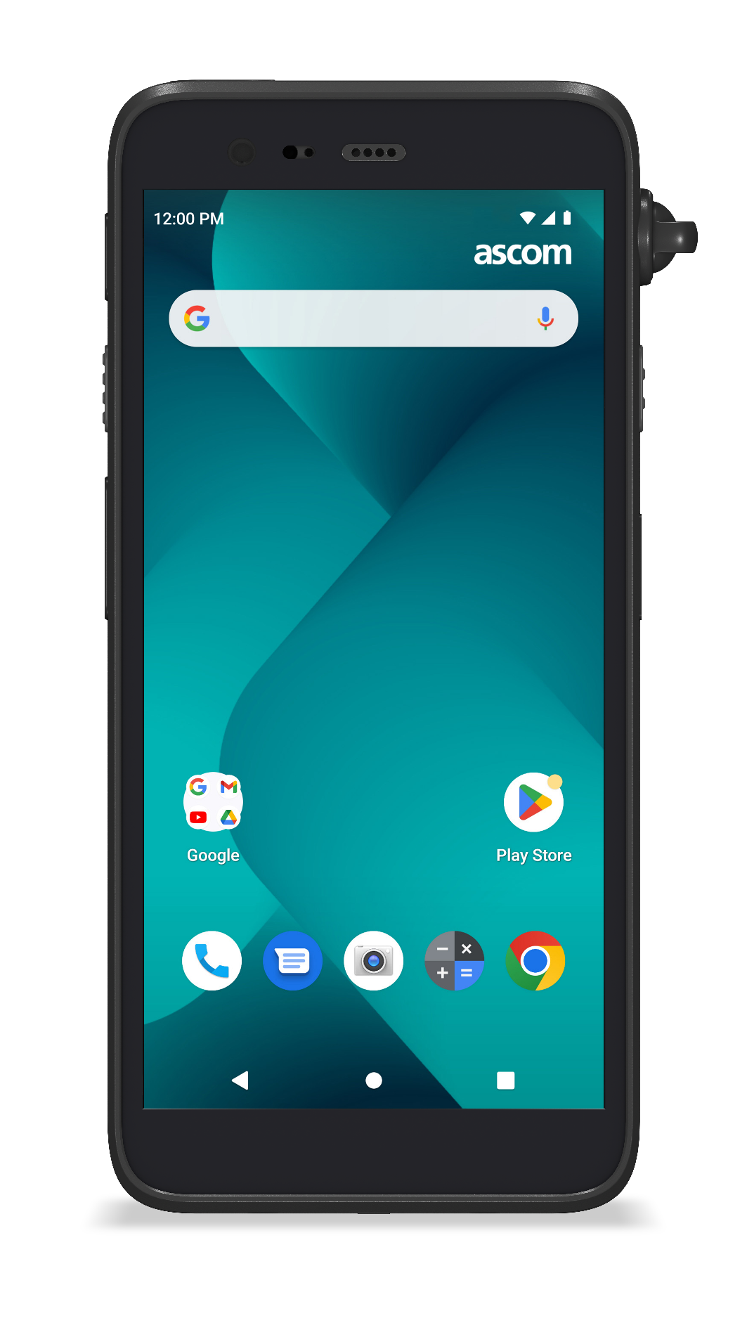
Ascom Myco 4 – DECT enabled
Reliable mission-critical alerting at its very best
DECT – a global standard for Digitally Enhanced Cordless Telecommunication
Interference-free communication over dedicated radio frequency bands
SIP-based telephony with certified interoperability with leading PBX vendors
Wideband audio for high-definition speech quality
Intelligent alert notifications via Unite Axess app (system redundancy)
Wi-Fi 6E – 802.11 family of standards for ’Wireless Local Area Networking’ (WLAN)
Intelligent alert notifications via Unite Axess app
Access to integrated clinical systems e.g., MDI, EMR, telemetry, etc.
Access to Apps, Internet and Google Mobile Services
Support for Ascom Personal Alarm and Clinical Collaboration suites
Easy deployment with Centralized Device Management via MDM/EMM
Including over-the-air (OTA) firmware updates
Notes:
* In US – DECT uses 1920- 1930MHz frequency allocation, also known as UPCS band. NOTE: this allocation is not technology exclusive, but is, in practice, "clean" enough to achieve similar interference-free operation.

Slide 17
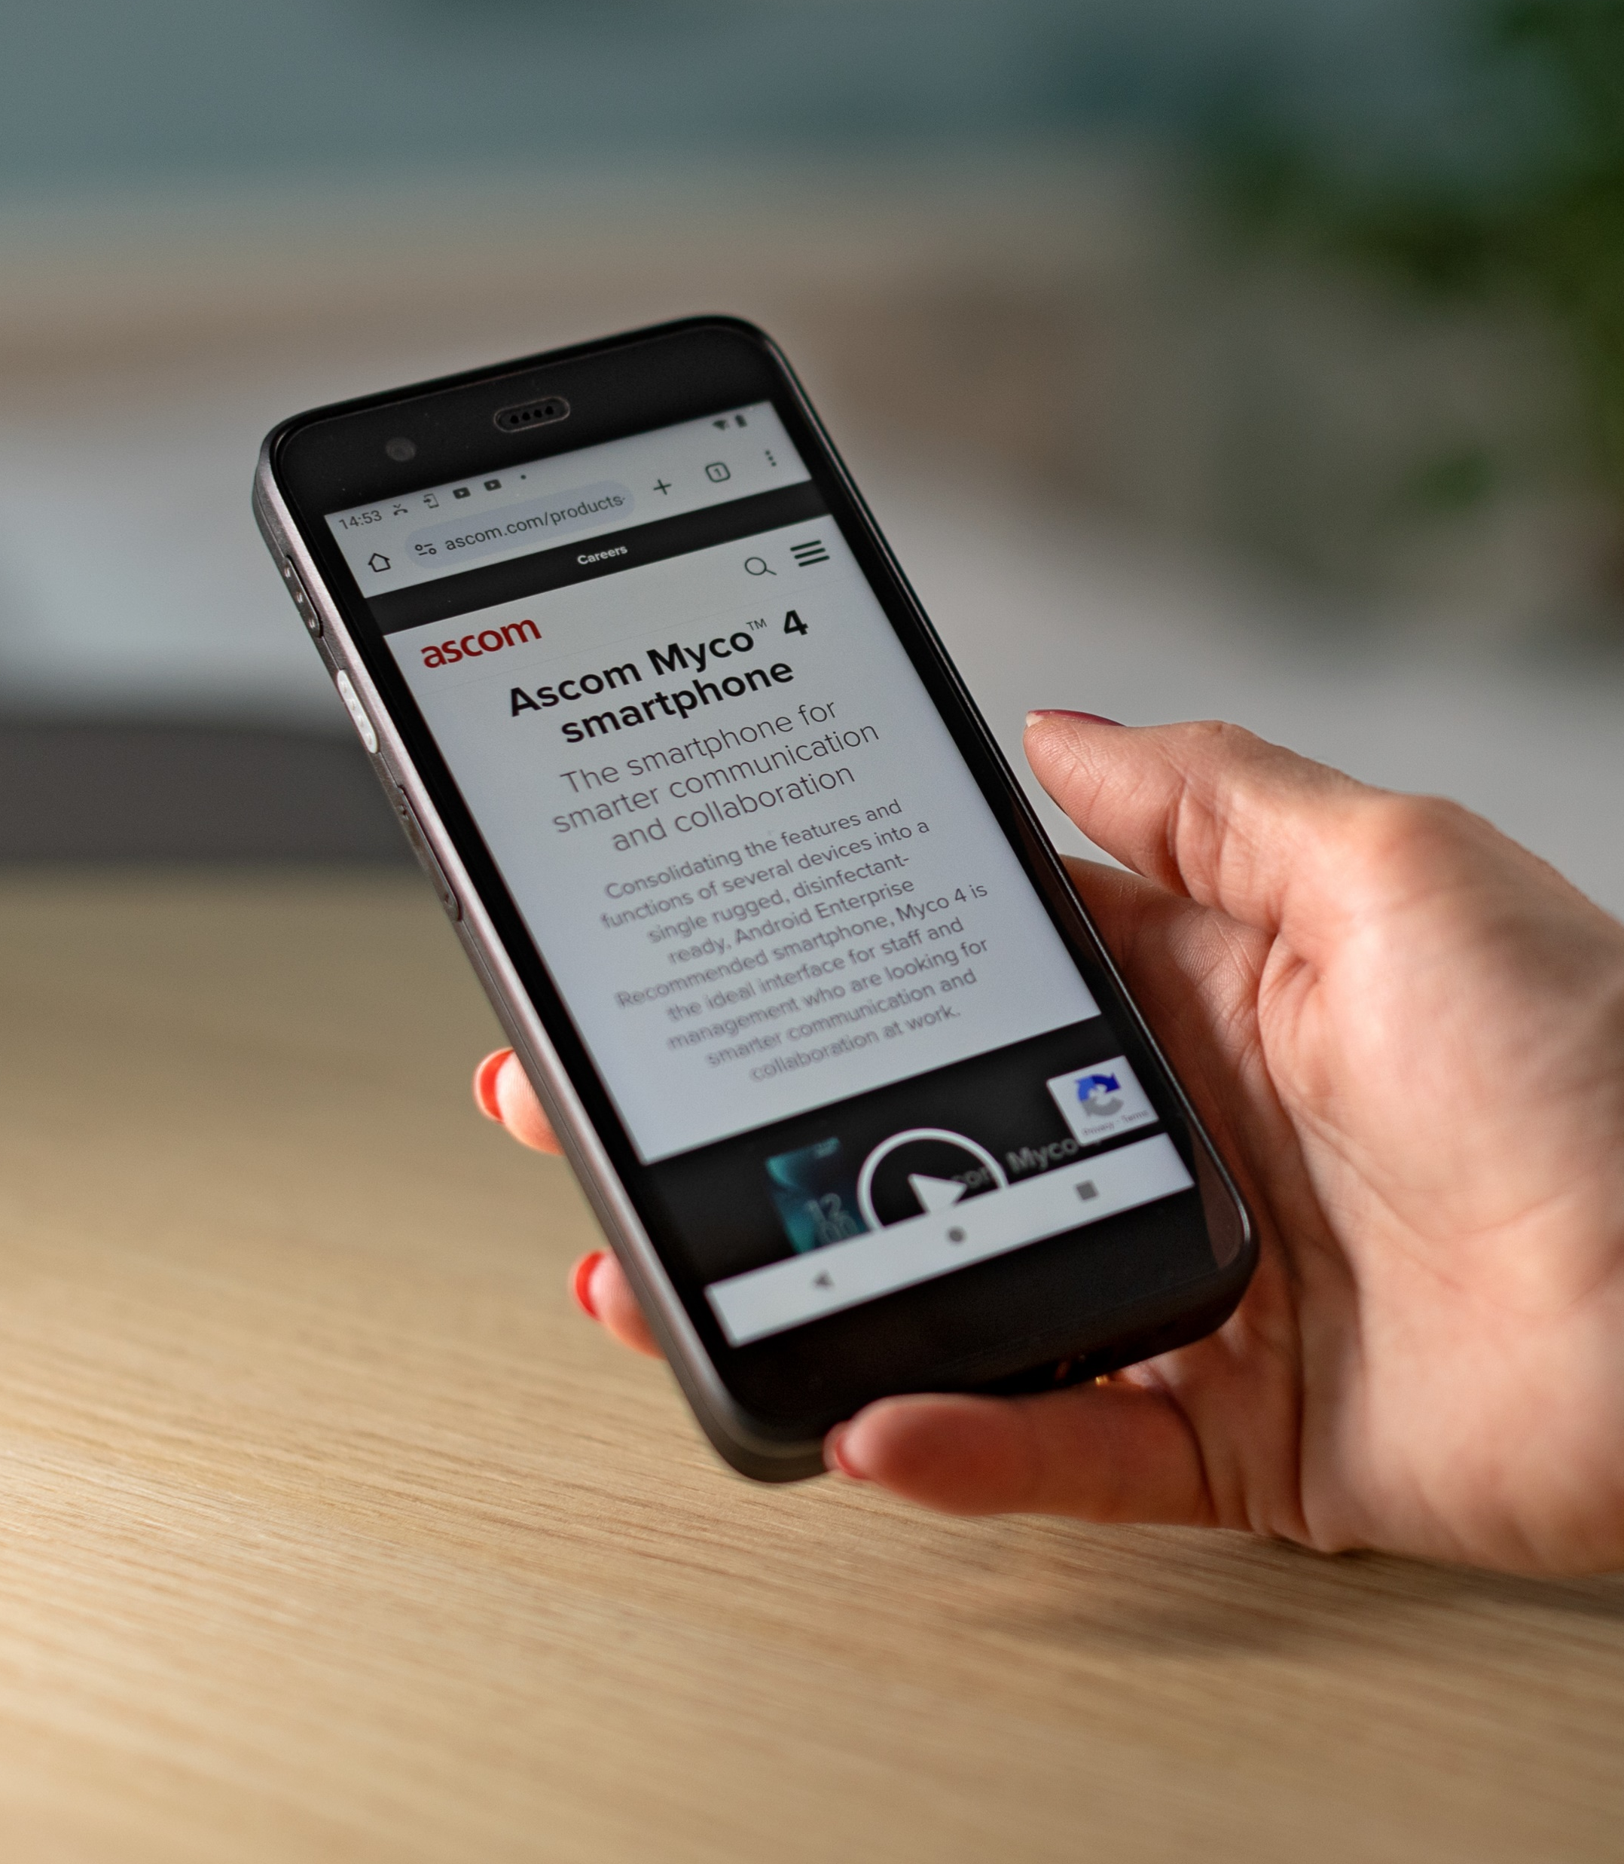
Wi-Fi – access to enterprise
LAN & Apps
Reliable access to the Wireless Local Area Network
Wi-Fi is a set of protocols, based on the family of IEEE 802.11 standards, for wireless local area networking and modern-day Internet access.
Ascom Myco 4 delivers enterprise-grade Wi-Fi performance, backed by certified interoperability testing with leading Wi-Fi infrastructure vendors.
Support Wi-Fi 6E, delivers high data throughput ensuring consistent performance of enterprise applications and services.
https://www.wi-fi.org/who-we-are
Wi-Fi Alliance is the worldwide network of companies that drive global Wi-Fi adoption and evolution through thought leadership, spectrum advocacy, and industry-wide collaboration.
Notes:
NOTE: Support for SIP protocols over Wi-Fi and Wideband audio (i.e.,G.722 codecs) means Ascom Myco 4 DECT can also be configured as a VoWiFi handset.

Slide 18
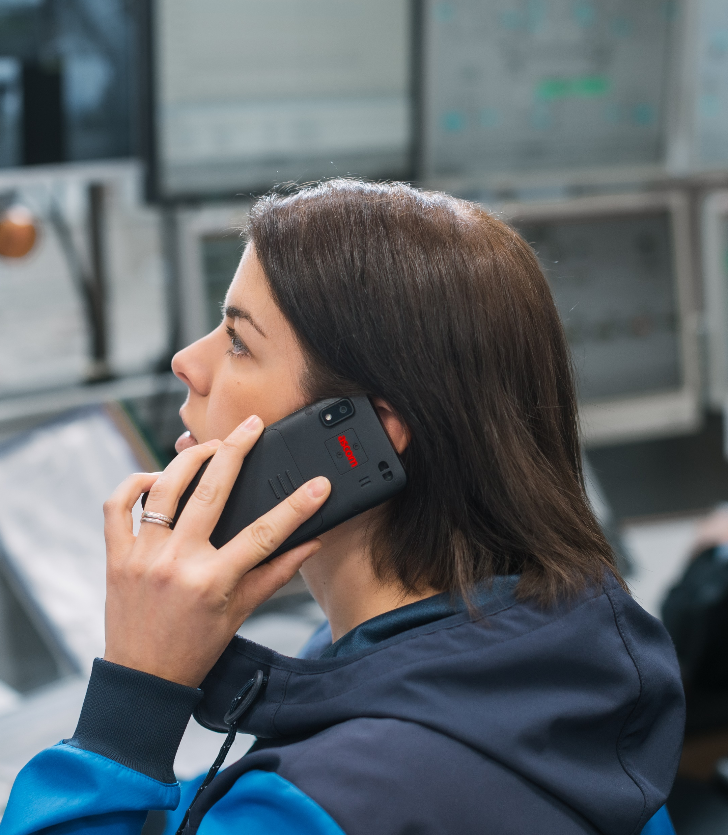
DECT – best performance wireless telephony
Digitally Enhanced Cordless Telecommunication
DECT is the de-facto global standard for on-premise wireless voice/telephony applications. It dominates all other on-premise voice technologies (i.e., including VoWiFi, analogue and other proprietary technologies).
A truly global standard with unparalleled worldwide acceptance, interoperability, and compatibility with global standards for telephony (i.e., PSTN, PABX and VoIP) applications.
Using Wideband audio (i.e., G.722.2 codecs) further enhances voice quality. Thus, enabling conversations with clearer more natural sounding speech quality
https://www.etsi.org/technologies/dect
ETSI is a leading European standardization organization for Information and Communication Technology (ICT) standards fulfilling global market needs.
Notes:
According to ETSI - DECT is the ESTI’s second most successful and widely adopted global telephony standard after GSM (i.e. Cellular). The market for DECT devices continues to grow with ~100 million devices per year.
DECT is the global de-facto standard for cordless telephony applications. It dominates all other on-premise wireless voice technologies (i.e. including VoWiFi, analogue and other proprietary). No other cordless technology can compete in terms of world-wide acceptance, interoperability, and capability with global standards for telephony (i.e., PSTN, PABX and VoIP) applications.
The DECT frequency spectrum allocation is 1880-1930MHz in Europe. This spectrum is unlicensed* and technology exclusive, which ensures “interference free” operation. In US the frequency allocation is 1920- 1930MHz, also known as UPCS band. NOTE: this allocation is not technology exclusive, but is, in practice, "clean" enough to achieve similar interference-free operation.

Slide 19

Myco 4 features
Built for your professional needs

Slide 20
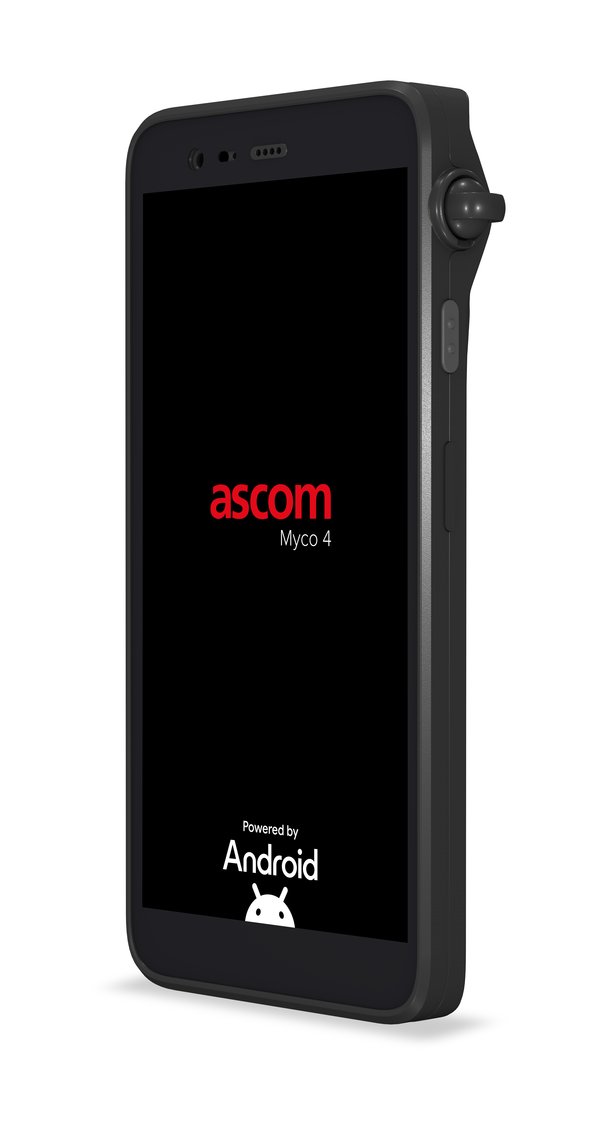
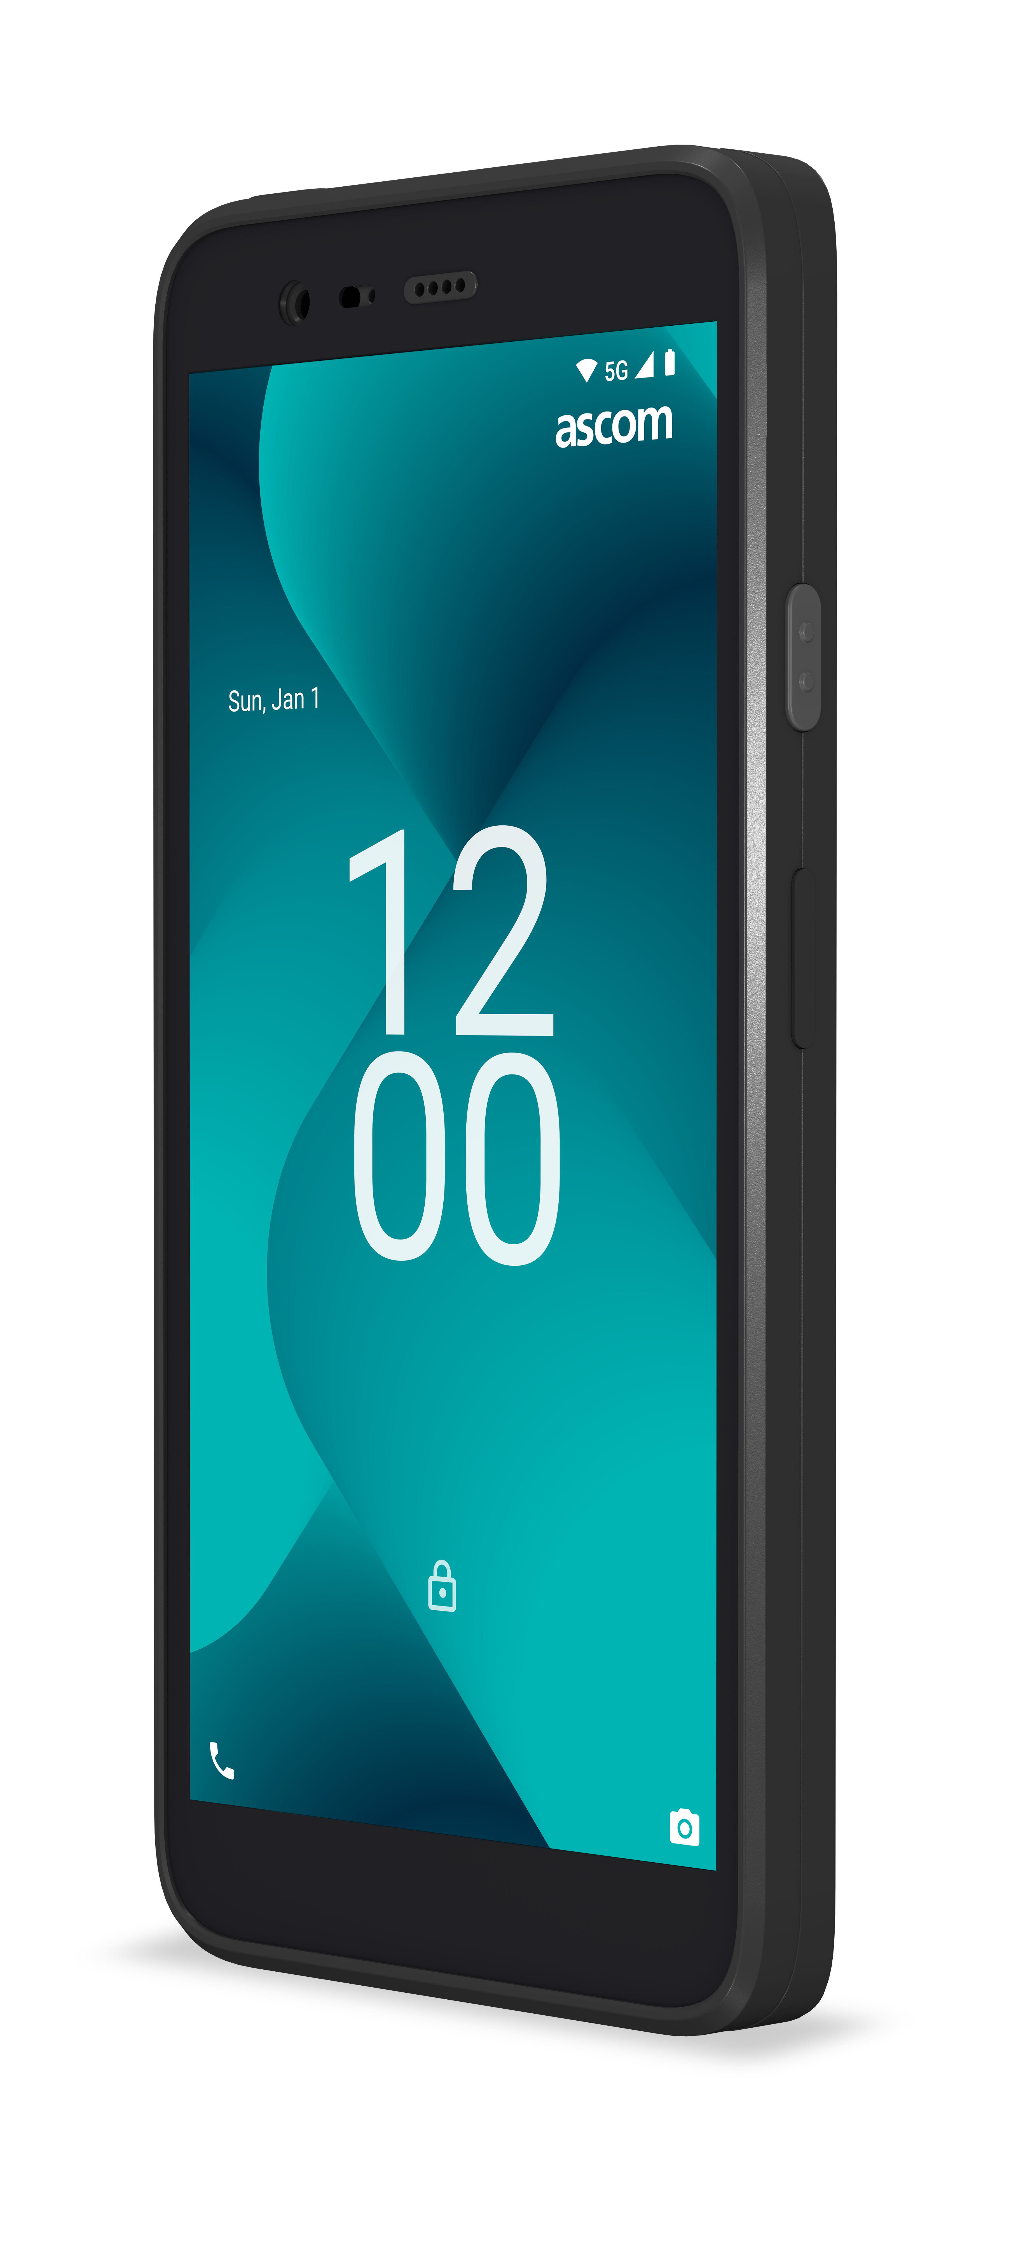
Myco 4 – larger vivid and durable display
5.5” high-definition multitouch display
Highly strengthened Corning® Gorilla® Glass 5 – survives typical waist-high drops (i.e., up to 1.2m)
onto hard, rough surfaces.
To further enhance the brilliant durability of Gorilla Glass 5, Myco 4 comes with a factory mounted screen-protection film. In case it wears out, the screen-protection film is available as a spare part and can easily be replaced.
Available in two form factors

Slide 21
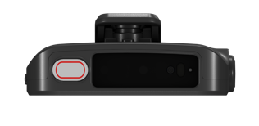
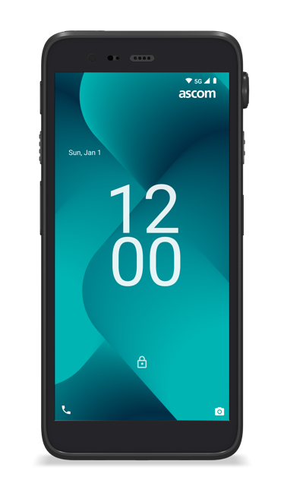
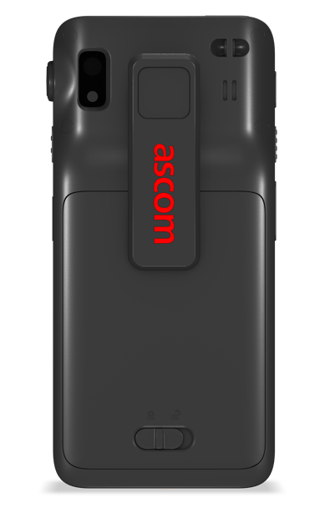
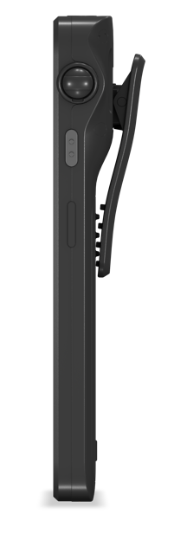
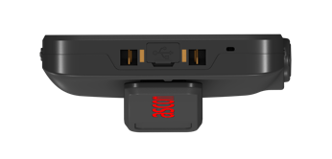
Myco 4
– advanced optics
Optional ‘high-performance’ barcode scanner
Industry-grade SE4720 barcode scanning engine
with smart aiming, that illuminates scanned surface
to improve readability with visual pointer to guide
the user for improved accuracy.
New higher performance cameras
50 Megapixel rear-facing camera
8 Megapixel front-facing camera

Slide 22
Myco 4
– multi-function buttons
Customer configurable function buttons (4x)
Each button can easily be configured to quickly
activate frequently used functions:
alarm button
activate barcode scanner
open EMR app
call emergency number
trigger silent alarm
PTT button
flashlight, etc.

Slide 23

Myco 4
– advanced personal alarms
Promoting staff safety and peace of mind through
advanced alarm capabilities
A wide array of location technologies to further enhance personal safety
Easily trigger a push button alarm when the user perceives imminent threat or danger
Alarms can also include details of location using
IR, BLE, GPS and Wi-Fi technology location
Pull-cord alarm in case the handset is snatched
from user
Automatically detect and trigger man-down/
no-movement alarms, if user is incapacitated
Call-after-alarm enables responders to quietly
listen in via discreet open mic to the Myco 4
Notes:
Multiple supported location technologies to pinpoint user’s last known location and direction of travel
Automated silent call after alarm allows response teams to listen in as they approach
Optional pull-cord alarm in case handset is snatched
Enables fast coordinated responses directly to the staff member’s location
Assures staff that they will be located (even if they are incapacitated “man down”)
Enables fast coordinated responses directly to the staff member’s exact location
Helps staff members feel secure

Slide 24
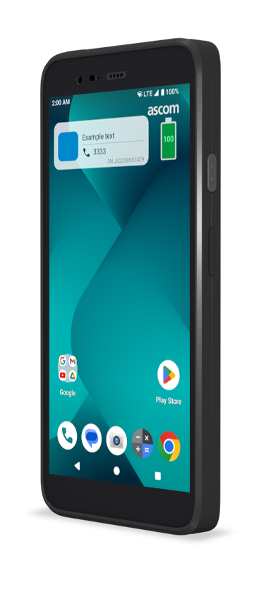
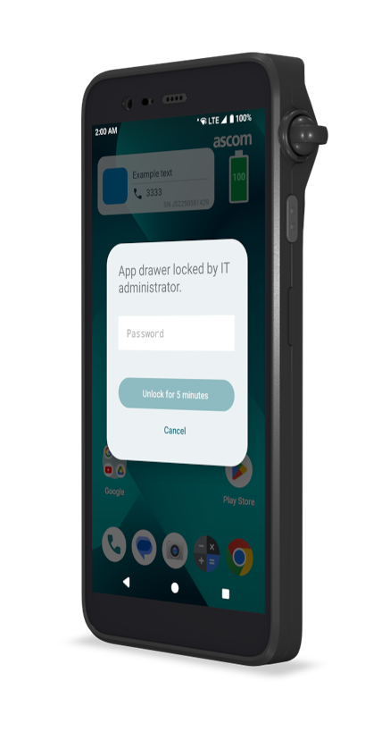
Myco 4
– reliable inside and out
Create reliability in communications and mission-
critical workflows
New feature additions to Android to avoid both intentional and unintentional misuse:
Minimum volume level to ensure every call and notification is heard
Hide potentially dangerous setting tiles
(e.g. airplane mode, Wi-Fi)
Lock home screen layout changes
Password protected settings to prevent misuse
Alerts users, if SIM card is malfunctioning
Resets volume to a default after charging
Block access to app drawer to restrict access to apps
User restricted mode prevents unintentional misuse.
Notes:
Looking for the ideal platform to integrate your mobile workflows?
Look no further - Ascom Myco 4 deliver an innovative mobile application platform, adressing the demanding needs for professional users.
Running Android OS onboard, Ascom Myco 4 host an open, powerful, well-known and trusted environment for any Android mobile business applications that can help solve everyday problems across all verticals and a vast variety of use cases.
In addition Myco 4 has unique software and hardware capabilities that enables more solutions and feature-rich apps – making mobile workflows even more productive.
Apps can access Myco 4 interfaces and APIs to integrate with built-in barcode scanner, trigger actions by dedicated physical buttons, use top-mounted color LED to alert users, get device location or access no-movement/man-down sensors.
Apps can also be supervised by Myco 4 to ensure they are operational at all times – a true testimony to the mission-critical capabilities provided by Myco 4.
Integrations are made simple by using the Myco APIs SDK to further ease any development.

Slide 25

Integrate apps with Myco 4
Harness unique device APIs for business apps
Open, well-known and trusted environment for any mobile Android business apps by running Android OS
Enhance app features and user experience by integrating apps with unique Myco 4 hardware features
  Apps can access Myco 4 interfaces and APIs to:
  – integrate barcode scanner for a seamless experience
  – trigger actions via multi-function buttons to quickly activate
  frequently used functions
  – use top multi-color LED to alert users with urgency indication
  – get device location, including BLE, IR- and NFC-based location
  – access no-movement/man-down sensors for personal alarms
  – supervise the app for automatic restart, if it crashes
    Guides, SDK and example code support easy development
Notes:
Looking for the ideal platform to integrate your mobile workflows?
Look no further - Ascom Myco 4 deliver an innovative mobile application platform, adressing the demanding needs for professional users.
Running Android OS onboard, Ascom Myco 4 host an open, powerful, well-known and trusted environment for any Android mobile business applications that can help solve everyday problems across all verticals and a vast variety of use cases.
In addition Myco 4 has unique software and hardware capabilities that enables more solutions and feature-rich apps – making mobile workflows even more productive.
Apps can access Myco 4 interfaces and APIs to integrate with built-in barcode scanner, trigger actions by dedicated physical buttons, use top-mounted color LED to alert users, get device location or access no-movement/man-down sensors.
Apps can also be supervised by Myco 4 to ensure they are operational at all times – a true testimony to the mission-critical capabilities provided by Myco 4.
Integrations are made simple by using the Myco APIs SDK to further ease any development.

Slide 26


Maximizing interoperability via open industry standards
Android framework
Android apps
Ascom API
Seamless vendor-agnostic integration
with enterprise applications
System API
Device manufacturer apps
Privileged apps
Built on the Android Open-Source Project (AOSP) led
by Google, the Myco 4 operating system embraces
open industry standards, designed for interoperability
Ascom adds mission-critical extensions to Android 14 to increase information security
Open APIs for 3rd party developers and system integrators to access Myco 4 unique hardware and software features
System services
Android runtime
HAL
Native daemons and libraries
Linux kernel

Slide 27



Ascom Myco 4
An all-new ruggedized smartphone
The entire user interface is redesigned to be more spacious, comfortable and fluid. Android 14 delivers improved system performance and data security.
Always on, always improving – built-in malware protection that automatically actively scans new installs, checks all installed apps and clears threats daily.
The safest place to install apps. Every app is verified by Play Protect.
Streamlined enrollment and setup

Slide 28
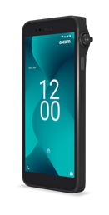

Works with Hey Google
Get more done on the go
Once activated - Google Assistant on Myco 4 is always with you
to help get things done and plan ahead so you can focus on
what matters most.
It brings the best of Google together in a natural and personalized way to help get things done fast.
Control your phone, favorite apps and your connected home while on the go using your voice.
It also helps you stay one step ahead with smart suggestions and reminders right when you need them, directly on your phone screen.
Just say “Hey Google” to get started.
Key features and benefits
Make calls or send texts
without typing – using just
your voice
Set reminders and alarms, pull up your calendar appointments, add things to your shopping lists and more while on the go
Get real-time answers or get quick translations
Easily control your phone setting and apps with just your voice

Slide 29
Summary Myco 4
Purpose-built to deliver value
Top to bottom – inside and out – designed to withstand tough demands of professional environments
A robust smartphone designed for shared and continuous use
across multiple shifts – contributing to operational efficiency
24/7 by 365; over a longer lifespan.*
A single professional-grade device that eliminates the need to
carry an entire tool belt of standalone devices.
Highly optimized wireless technology that enables reliable
mission-critical communications.
Ready for use with cloud PBXs
Built to last and meet the rigorous demands in healthcare:
Hot-swappable battery – Smart battery that can be swapped without shutting down
Drop/impact resistant – Designed to withstand impact from
typical drops of waist-high
Disinfection-ready – designed to comply with disinfection protocols
It’s my professional barcode scanner, my medical alarm pager, my messaging device, my walkie-talkie, my camera, my smartphone, my panic button, my wireless locator - in short - it’s “my companion” – Myco
* Compared to consumer devices

Slide 30
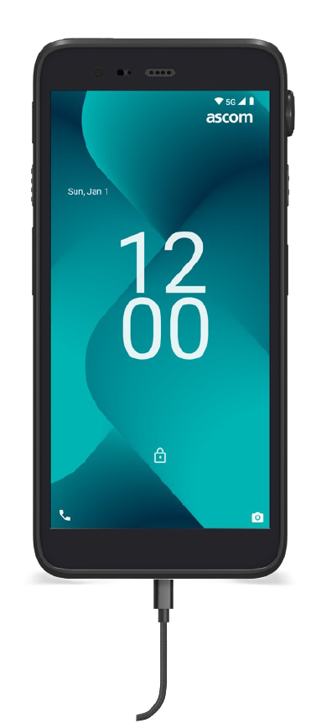
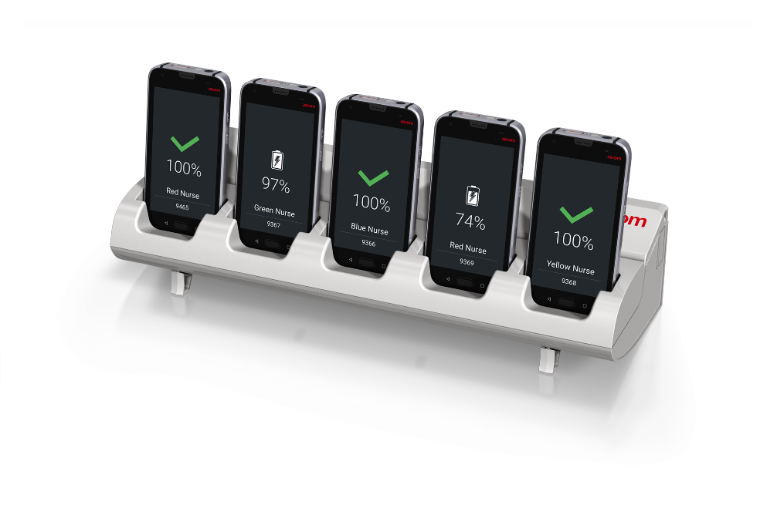
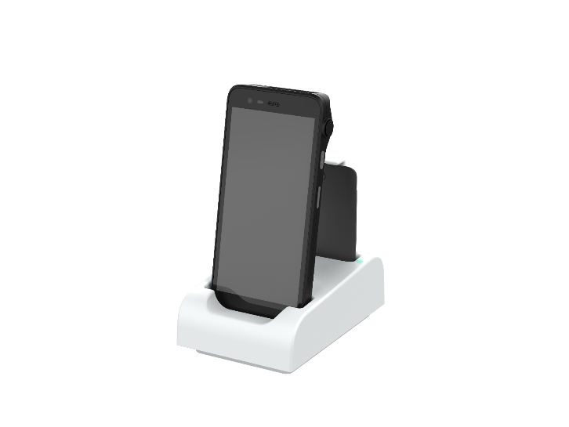
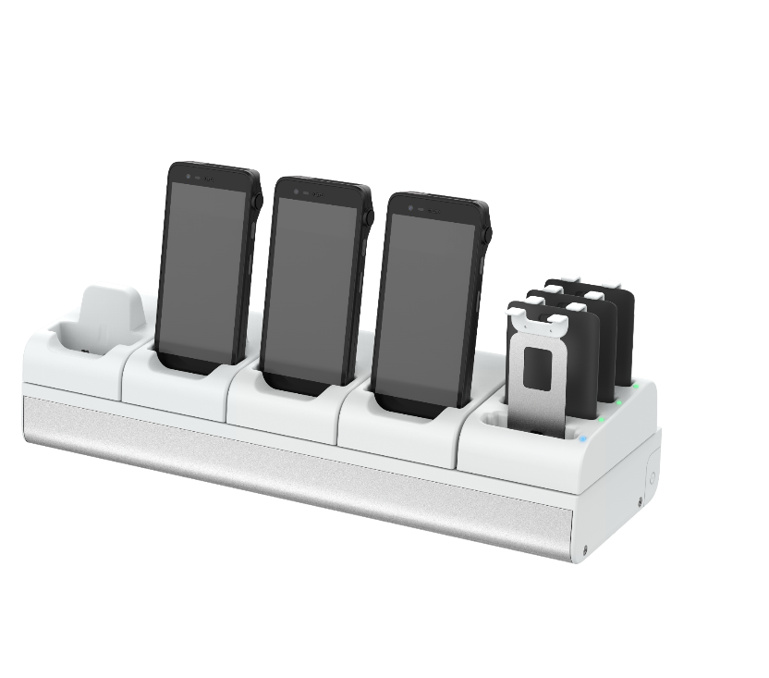
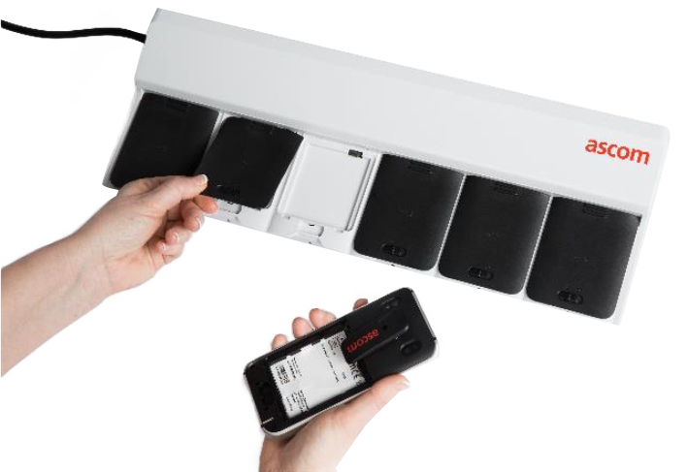
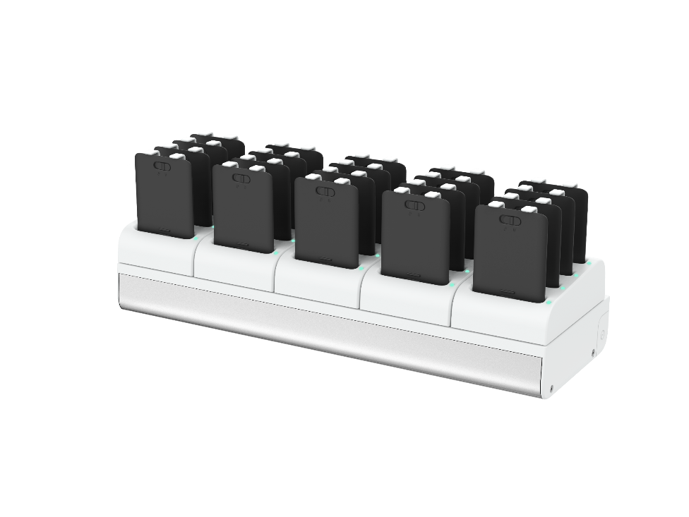
Flexible charging solutions
Modular charging concept
Quick charging with USB-C
Backwards compatible with
Myco 3 chargers
Flexible modular solution
Different charging modules for desktop use
Mix and match any combination of charging modules into charging racks
0% to 50% in just over half an hour
Easy migration for customers with Myco 3

Slide 31
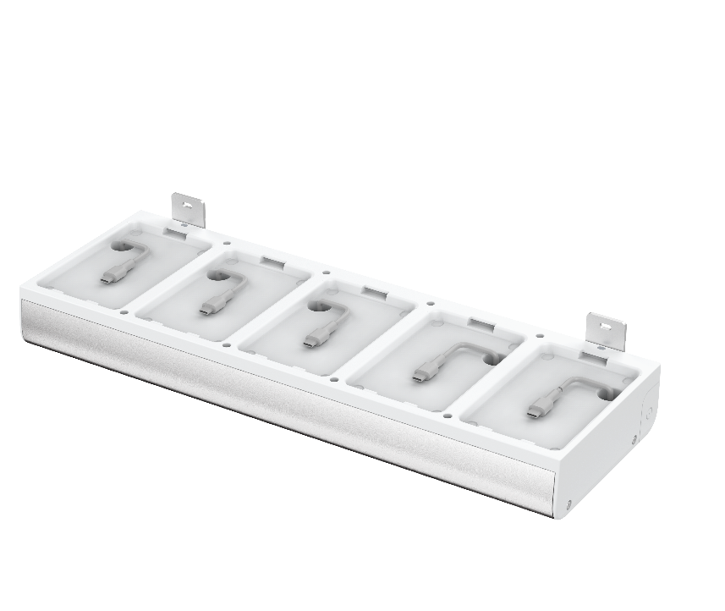
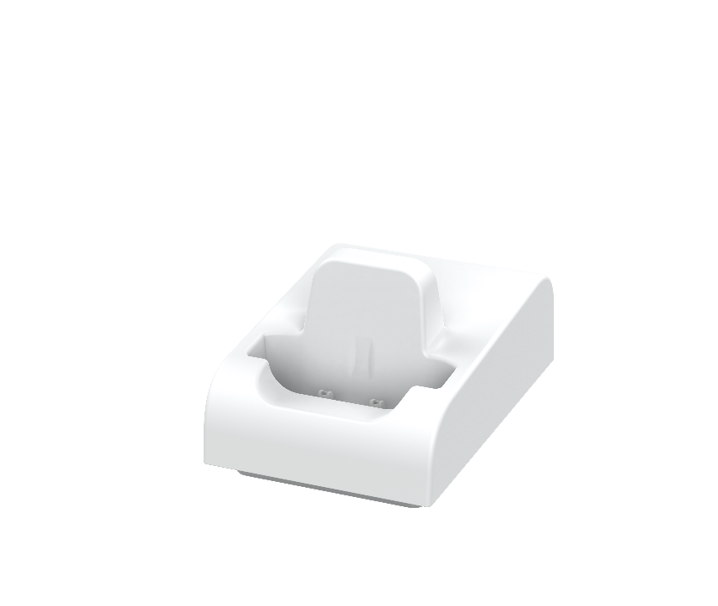
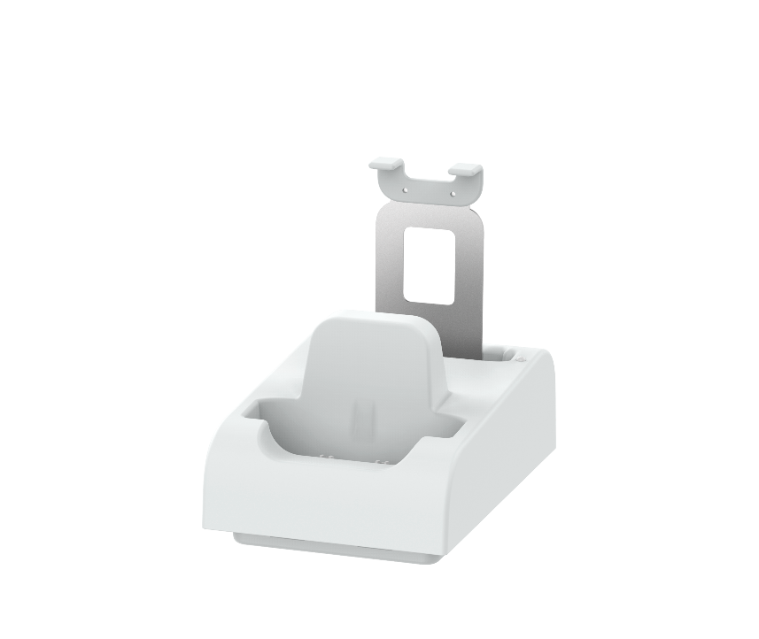
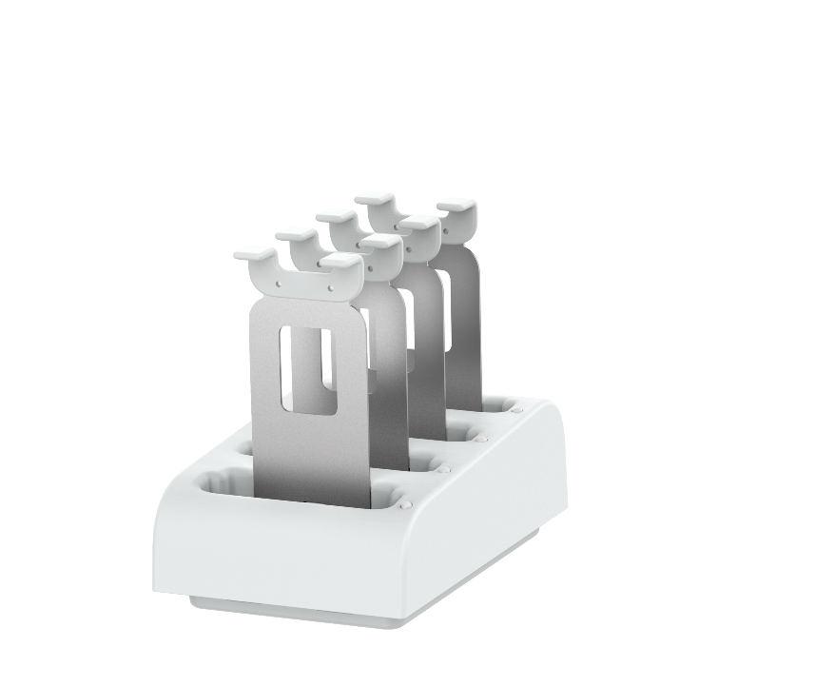
Modular charging concept – building blocks
Charger base
The base unit is the base for a rack configuration for several phones and/or batteries
Single charger module
Charger for one single Myco 4 phone
Phone + battery charger
Charger module that takes one Myco 4 phone plus one spare battery
Battery charger module
Module that charges up to four Myco 4 batteries at the same time
All charger modules can be used as stand-alone (desktop) chargers if powered with a proper USB-C power supply.

Slide 32
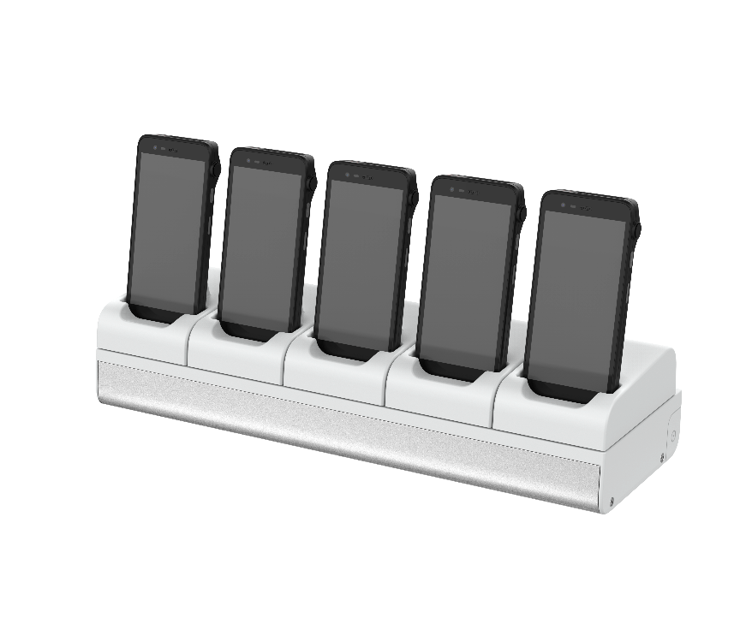


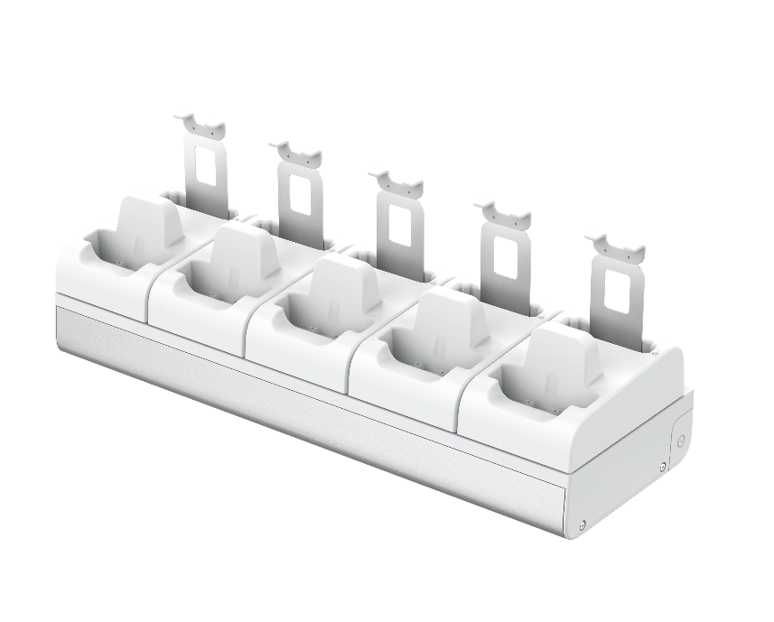
Configurations available for every taste
5 phones + 5 batteries
It is also possible to combine five desktop chargers in a rack configuration, to charge 5 phones and 5 batteries simultaneously
5 phones
Standard configuration for customers with personal phones
4 phones + 4 batteries
A good combination for charging both phones and batteries at the same time
20 batteries
Customers using the phones 24/7 and only charge batteries might prefer this charging solution

Slide 33

Q & A

Slide 34
Thank you!

Slide 35
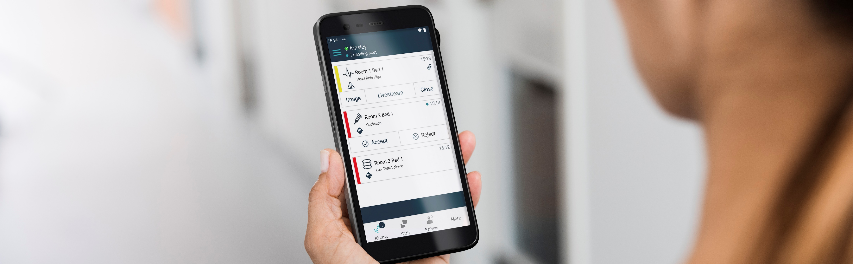
Appendix

Slide 36
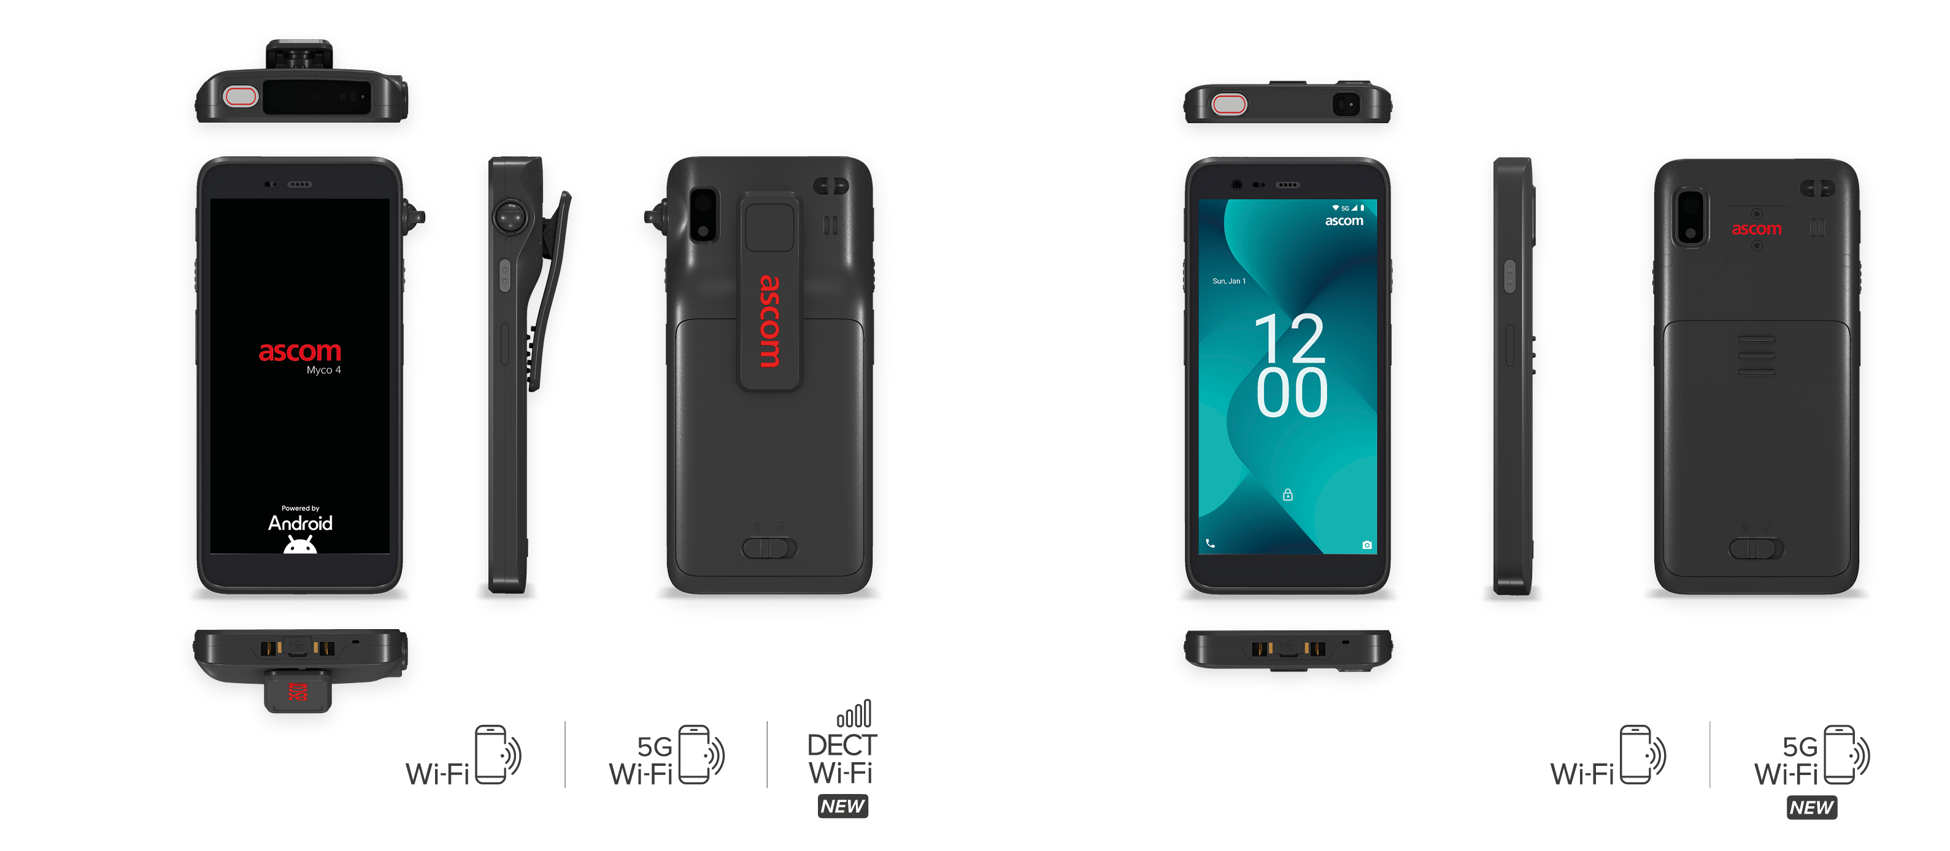
Ascom Myco 4 variants
Multiple devices to meet your unique needs
Ascom Myco 4
Ascom Myco 4 Slim

Slide 37



Ascom Myco 4 variants
Multiple devices to meet your unique needs
 | Ascom Myco 4 |  |  | Ascom Myco 4 Slim
Feature | SH4-AAB# | SH4-AAC# | SH4-AAD# | SH4-ABB# | SH4-ABC#
Android OS – with Ascom mission-critical extensions | ✓ | ✓ | ✓ | ✓ | ✓
Vivid 5.5” multi-touch display | ✓ | ✓ | ✓ | ✓ | ✓
Hot swappable battery – high capacity, easy replaceable, access to battery health | ✓ | ✓ | ✓ | ✓ | ✓
Multi-color LED notification beacon (top side) | ✓ | ✓ | ✓ | ✓ | ✓
Fingerprint reader | ✓ | ✓ | ✓ | ✓ | ✓
Rugged design – high impact and drop resistance | ✓ | ✓ | ✓ | ✓ | ✓
IP68 with high cleanability – Supports disinfection protocols i.e., high resistance to UV and chemical corrosion from disinfection wipes and solvents | ✓ | ✓ | ✓ | ✓ | ✓
50 megapixel rear camera + 8 megapixel front camera | ✓ | ✓ | ✓ | ✓ | ✓
4 x programmable multi-function buttons | ✓ | ✓ | ✓ | ✓ | ✓
USB-C port | ✓ | ✓ | ✓ | ✓ | ✓
Wi-Fi 6E, Bluetooth 5.2 (BLE) | ✓ | ✓ | ✓ | ✓ | ✓
Native SIP telephony – certified interop with major IP-PBXs | ✓ | ✓ | ✓ | ✓ | ✓
Professional barcode scanner with integrated aimer | ✓ | ✓ | ✓ | — | —
Camera based barcode scanner | — | — | — | ✓ | ✓
Pull-cord – advanced personal alarm feature | ✓ | ✓ | ✓ | — | —
Infra-red (IR) locator | ✓ | ✓ | ✓ | — | —
5G cellular (NSA/SA and Public/Sliced/Private) – dual SIM/eSIM | — | ✓ | — | — | ✓
Redundancy for Mission Critical Communication Dedicated DECT radio carrier for voice, personal alarm and alerts | — | — | ✓ | — | —
# Fourth position in item number depends on geographical region

Slide 38


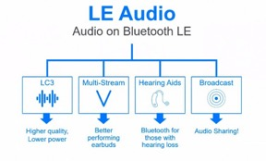

Ascom Myco 4
Rugged design – Wi-Fi &E Simple, elegant and effective
An extremely capable ruggedized smartphone designed with multi-color top LED notification beacon, a large 5.5” multitouch display, hot- swappable battery, several multi-functional programable buttons, and professional fast charging options.
A wide array of location technologies.

Slide 39
Ascom Myco 4
– battery and charging
Rugged design – Wi-Fi &E Simple, elegant and effective
Higher capacity hot-swappable battery
Intelligent 4000mAh battery - via API, it is possible to read battery health information.
Ascom CIC + USB-C interfaces
Backward compatible CIC interface common to the Myco family of product – with a new USB-C charging and data port. This allow Myco 4 to be charged with standard USB-C charger commonly available for consumer devices.
Notes:
CIC – Charging Interface Connector

Slide 40

Charger module – desktop use
Different modules available
The charging modules need to be powered by at least 18W USB-C power supply
Please use 660736 Power Supply and 660737 USB-C cable, already available in price list

Slide 41
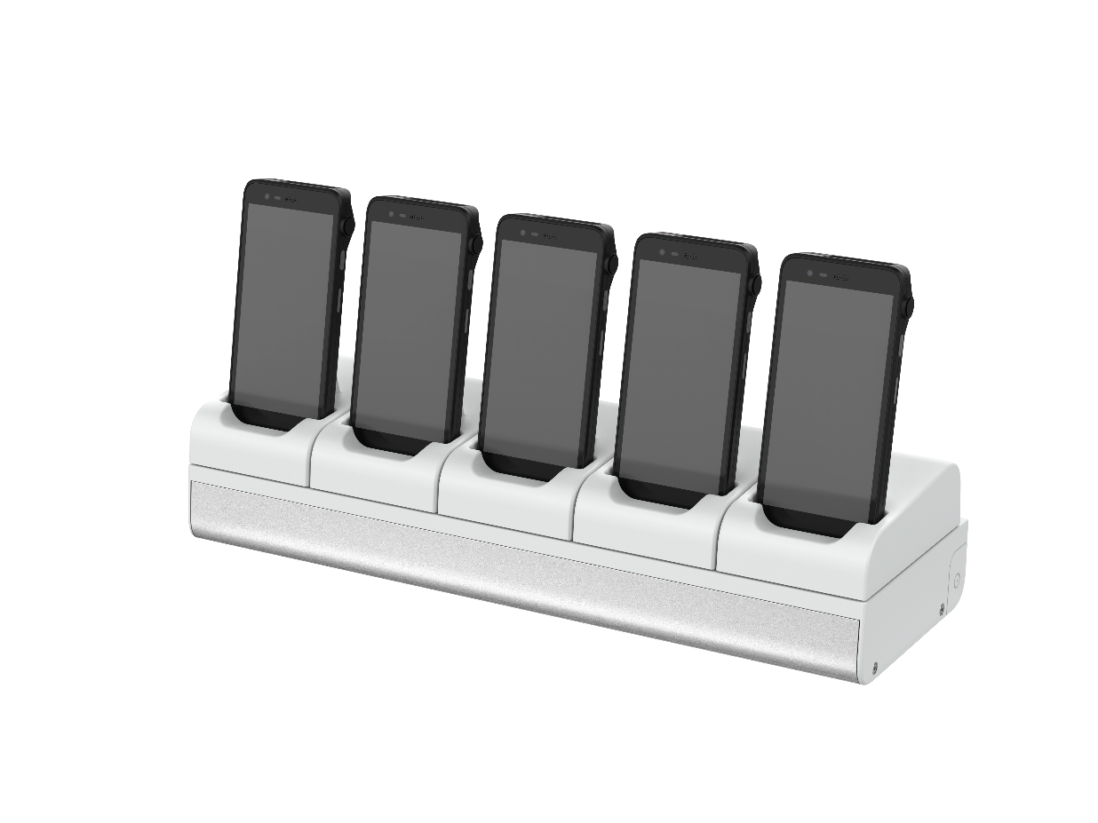
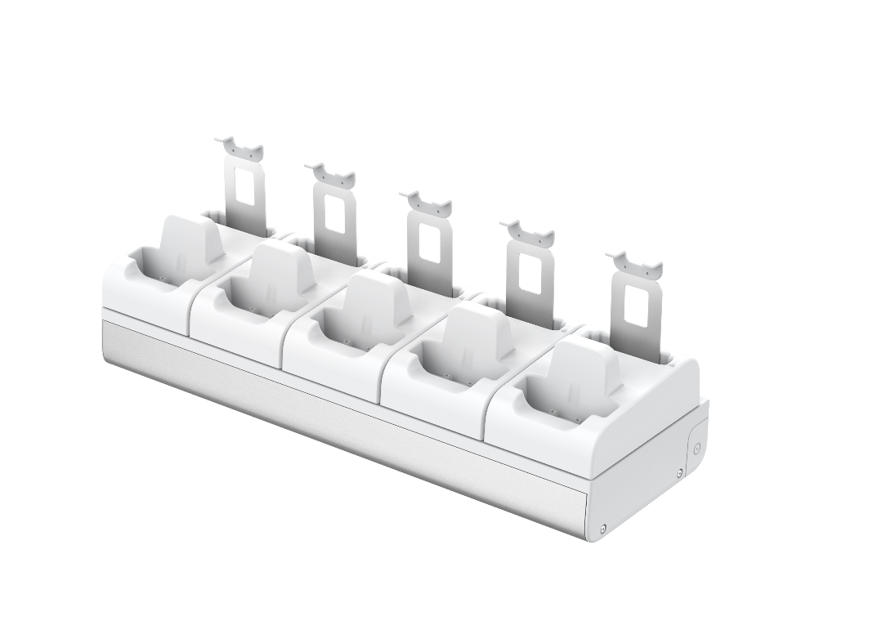
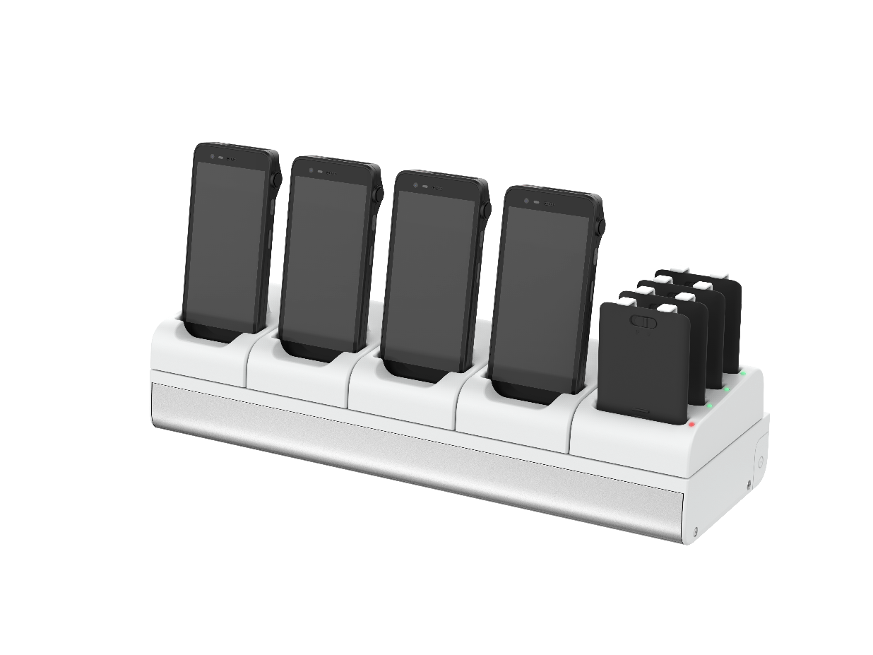

Combine any 5 modules to a charging rack
Three different modules available
Single handset charger module
Handset + battery charger module
Charger module for 4 batteries
Any combination of five charging modules can be used in a charging rack
Charger base has a built-in power supply

Slide 42

Modular charger – base unit
The base unit is the base for a rack configuration
for several phones and/or batteries
The unit can be placed on a desk or screwed
to the wall
When screwed to the wall the upper screw holes in the base unit aligns to the old charging rack screw holes for easy mounting
Pre-mounted power cable with a C14 contact, just as the old CRx charging racks.
To connect the charging rack to a power outlet, please use a cable with C13 connector, for instance 660329 (for Europe)

Slide 43
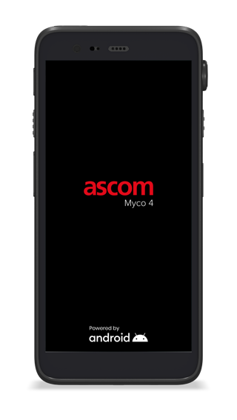
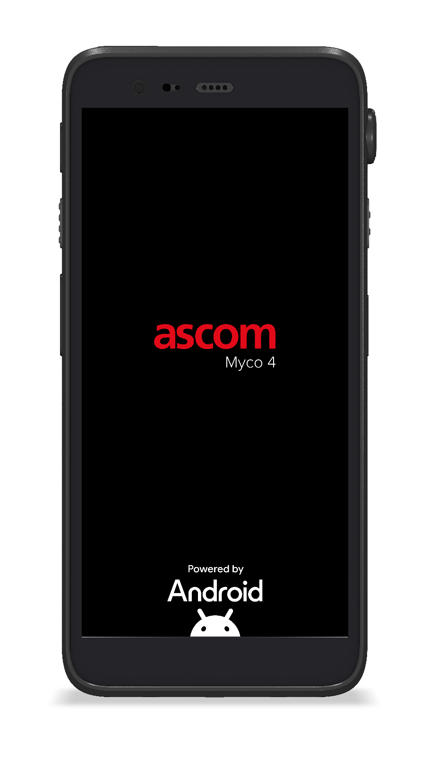
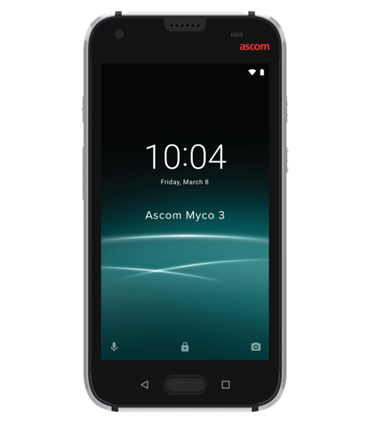
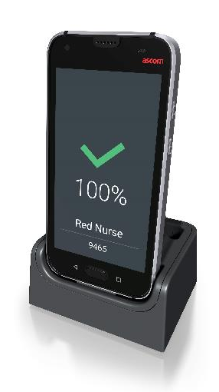
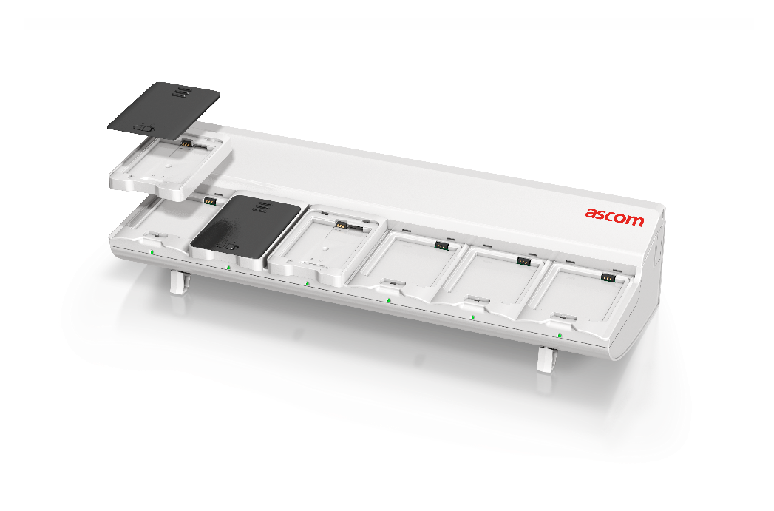
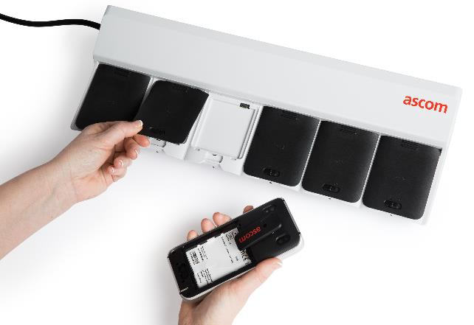
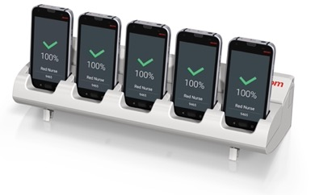
Seamless migration from Myco 3
– battery and charging
Backward compatible charging solutions
Easy migration from previous Myco versions
Backwards compatible hardware including:
Desktop charging (smartphone only)
Professional multi-bay charging racks
– adapter required to charge the battery

Slide 44
The Ascom software value “on top of” Android 1(2)
70+ customer/regional functional requests (CRs) implemented in the Ascom Myco portfolio
Fully Android integrated Ascom VoIP/SIP telephony client
User Restricted Mode - Avoid intentional or unintentional misuse
  Direct PBX integration – no app needed
  Well known and excellent user experience due to the Android integration
  PBX interoperability testing assuring quality and easy migration
  Shared phone with personal or shared extension
  SIP over Cellular e.g. to enable voice on Private 5G
  Multiline - up to 5 SIP extensions per device
  Push-to-talk (PTT)
  Configure minimum volume / prevent mute
  Configuration of the notification drawer e.g. remove flight mode toggle icon
  Configuration of power button action
  Protect settings with password
  Protect app drawer with password
  Prevent screenshot
  Prevent camera usage
  Control and lock the size and placements of apps and widgets
  Remove the Google search bar
  Prevent turn off notification via notification
  Default settings tuned for mission critical usage e.g. key shortcut to prevent ringing is turned off
Enterprise grade Wi-Fi and Cellular connectivity (Wi-Fi 6E & private 5G)
  Enhanced Performance and Reliability (connection stability, reconnection time etc.). Suited for VoIP and mission critical applications
  5G Standalone (SA), 5G Non-standalone (NSA), Private 5G
  Prioritize Cellular network / Prioritize Cellular data per app
  Extensive interoperability testing
Reliability, security and usability enhancements
  Read out caller ID / name
  Answer / Decline / Silent call with voice command
  Speakerphone mode optimized for pocket
  Myco widgets (Owner Id + Battery)
  Supports networks without internet connectivity
  Improved/earlier low battery warning
  Battery health supervision and warning
  Warning notifications for unexpected events e.g. connectivity loss
  Multicolor LED with app-controlled color and blink pattern
  Configure volume type on volume buttons
  Supervision of internal apps, Ascom apps and third-party apps – keeps apps alive
  Power-save mode optimized for reliability
  FIPS-validated cryptography
  Redundancy for alarm and messaging with DECT and Wi-Fi
Barcode scanner
  Professional HW scanner or Camera based depending on needs
  Ability to pick one code out of many with aimer dot or two-step viewfinder
  Rich set of configurations based on customer and partner needs.
  Validated with partners such as EpicPrioritize Cellular network / Prioritize Cellular data per app
  Extensive interoperability testing

Slide 45
The Ascom software value “on top of” Android 2(2)
70+ customer/regional functional requests (CRs) implemented in the Ascom Myco portfolio
Charger profiles/behavior
  Configurable Multifunction buttons
  Rack charger screen for quick and accurate selection of device e.g. by name, number, color and state of charge.
  Create profile for different behavior when putting the device into a charging rack or a desktop charger versus using it normally. E.g. set volume to silent, presence to absent and log out application.
  Set the device to the same know state each time removed from charger e.g. set ring volume to a specific level.
  Supports various features e.g. Personal alarm, Bar code, Push-to-talk (PTT), speed dial, flashlight and Google voice assistance etc.
Extended logging and troubleshooting
  Syslog, Remote error monitoring, Event log UI requested by end customers and Ascom support organization.
Personal alarm
Ascom 3rd Party API / SDK
  Personal security e.g. Alarm button, Pull-cord alarm - configurations to avoid false alarms
  Man-down & No-movement alarms – battery optimized
  Enables Ascom and 3rd party apps to use e.g.
  LED (alert indicator)
  Location (IR / Wi-Fi)
  Supervision (keeps apps alive)
  Movement (Man-down / No-movement alarms)
  Telephony (SIP registration / PTT / Identifiers / Contact look-up)
  Barcode
Positioning
  Various location / positioning capabilities e.g. Wi-Fi, RTT, GPS, BLE (tag and receiver), DECT and IR. Mainly for alarm and workflow solutions
Partnerships, certifications and interop
Device Management
  List of 30+ companies we maintain partnership, certifications, and interoperability with e.g. Google, Epic, Meditech, Philips, Airista Flow, Ericsson.
  Android Enterprise Recommended certification
  MDM/EMM support, certifications and intop
  Large scale device deployment and management Over The Air e.g. grant app perissions and battery optim. whitelist via MDM
  Small scale device management local on device (USB/QR/UI)
  OEMConfig app, for configuration over MDM/EMM systems (including additional settings missing in the EMM systems, based on customer demands)
  SOTA (Software Over The Air) upgrade, internet not needed. Admin to decide what units to update, when to update and if user needs to approve or not.
Extended lifetime and security support
  Android upgrades extended to Android 18
  Extended software support
  Security updates extended until December 2031 (at least)
Customizable via Change Request procedure
  Ability for customers to make change requests e.g. new functionality, new operators and Private Networks, interop, certifications.
  70+ request implemented in Myco 3 and 4

Slide 46
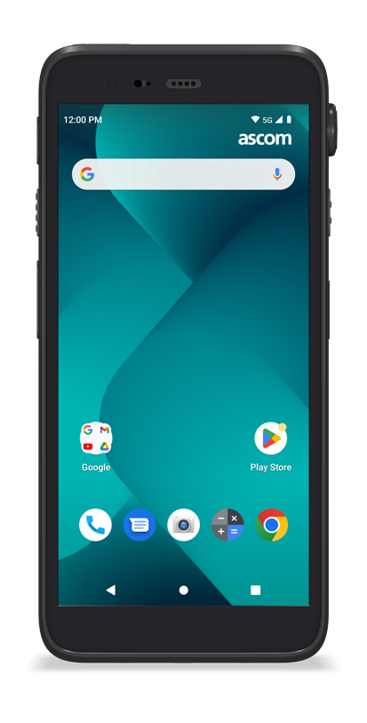







Several Google apps pre-installed
Myco 4 comes with the best Google apps pre-installed, so it's ready to use right out of the box. Google Calendar, Google Search, Google Maps, Chrome, Google Drive, and so much more — ready for you to enjoy on your phone.
And with Google Play Store you can access millions of apps, books, and other resources.

Slide 47


Google Play protect
Always on, always improving protection
Google Play Protect is built-in malware protection that works to keep your device clean and your data safe. It scans and clears away threats automatically, updates to stay a step ahead and
helps you locate your device if you lose it. Your device and personal data are worth protecting. With ever-evolving protection powered by Google's machine learning systems, Google Play Protect has you covered.
Play Protect comes built into your device. It actively scans new installs and checks all installed apps daily. As Google learns from over 2 billion devices, protection gets stronger in real time.
Google Play is the safest place to install apps. Every app is verified by Play Protect and our protections are constantly improving.

Slide 48
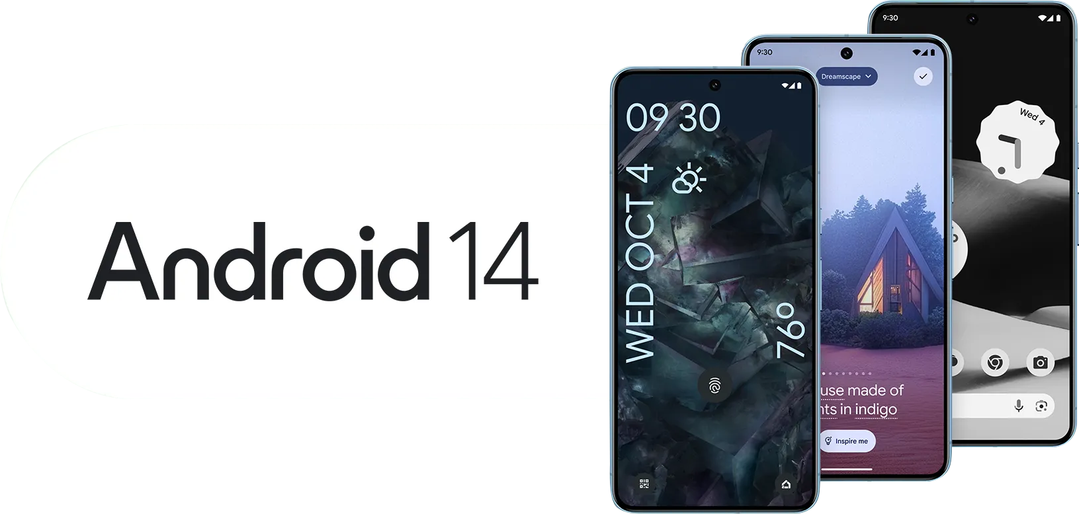

What’s new on Android 14
Personal
Monochrome themes
Lock screen customization
Generative AI wallpapers
Protected
Data sharing updates
Health connect
Enhanced PIN security
Accessible
Improved magnification
Nonlinear font size scaling
Font size Quick Setting tile
Hearing aids improvements
Flash notifications

Slide 49
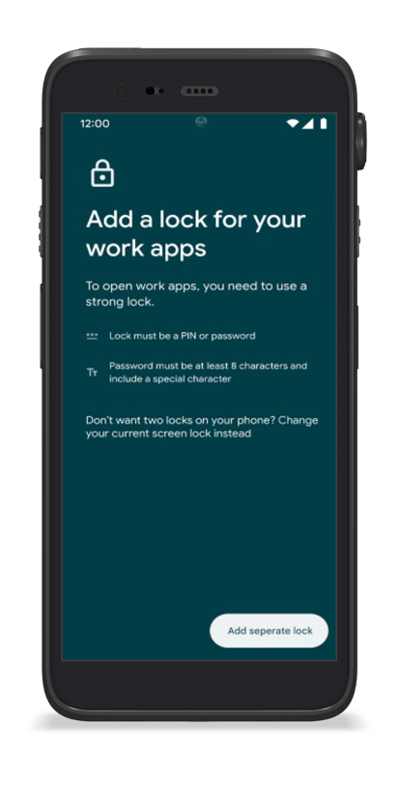
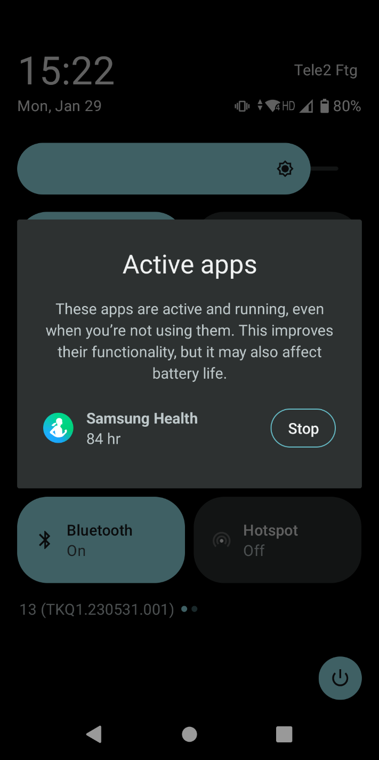

Android 13
Android 13 is an incremental update, including:
Additional features to improve the security of the phone
Improved user experience
Optimization for battery consumption

Slide 50

Android 12
Streamlined enrollment and setup
Android 12 introduces a streamlined enrollment and setup process for users while taking into account device lock requirements for admins. Employees can still use just one lock for their devices and their work profile. In the event IT requires users to set a separate password for accessing the work profile, we’ve improved the setup process to prompt employees if their provided password doesn’t meet complexity requirements set by their admins.
IT Administrators will have the ability to disable USB signaling for anything but charging, enabling organizations to reduce attack surfaces for their devices.

Slide 51
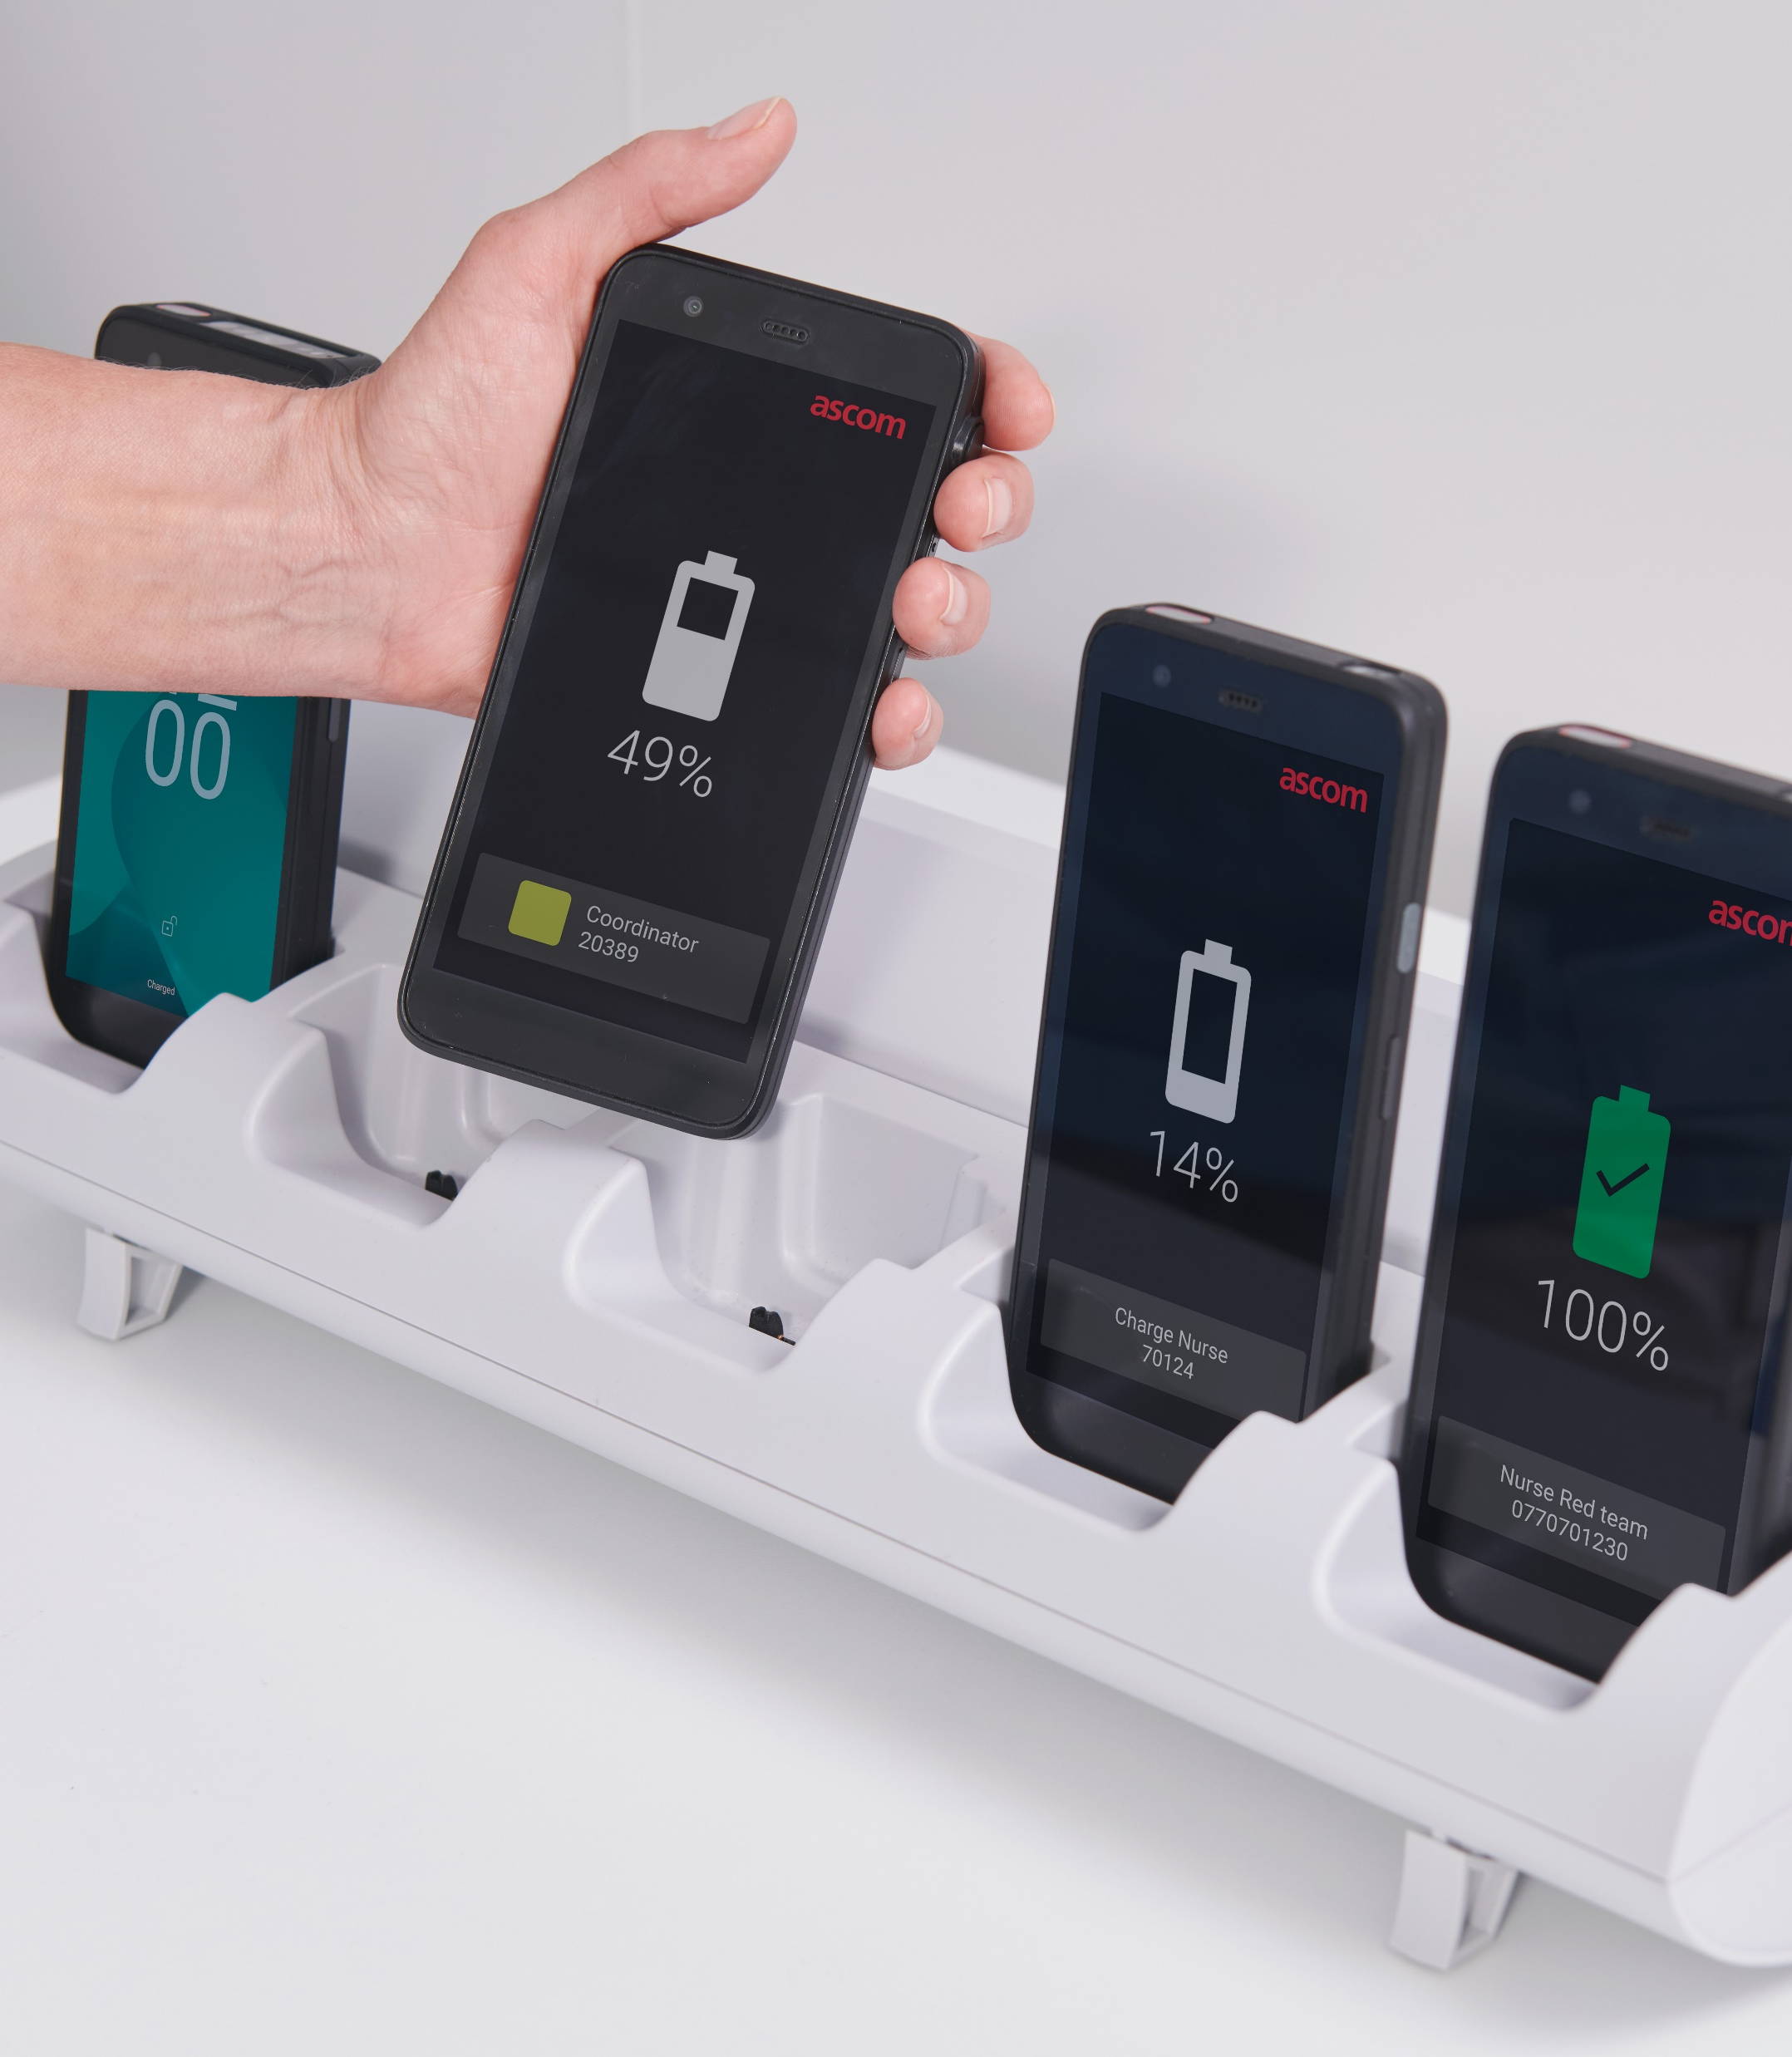
Total Cost of Ownership (TCO) with Ascom Myco 4
How to minimize your TCO with Ascom Myco 4
Ascom Myco 4 is a professional smartphone that can help to minimize your TCO over a longer lifetime.
Hot-swappable battery, requires fewer devices
Multi-chargers for devices and batteries
Robust, no extra cover and fewer damaged devices
Android security updates guaranteed for the lifetime
With Ascom Myco 4 it’s possible to save up to 50 % *
* Calculation done with a consumer phone price at 2/3 of Myco 4

Slide 52

TCO – Ascom Myco 4 vs. Standard smartphone
Example with 100 users
 | Ascom Myco 4 | Standard smartphone | Comments
Users and Devices | 100 users -> 100 pcs (plus 10 rack chargers, 100 extra batteries and 17 battery chargers) | 100 users -> 150 - 200 pcs | Standard devices must be charged, need for extra devices, many times double up (2x).
Replace device or battery (when the battery is bad) | Replace 200 batteries in 18-24 months | Replace 150-200 devices in 18-24 months. | Keep the Ascom Myco 4 and replace only the battery.
Replace a device due to damage | Expected 5% = 5 pcs per year. | Expected 5-10% = 10-20 pcs per year. | Ascom Myco 4 is a robust device and it has a clip to prevent drops.
Equipment in 4 years | 120 devices, 10 rack chargers, 17 battery chargers, 300 batteries | 360 – 480 devices | Ascom Myco 4 is more cost efficient over a longer time.
Cost in 4 years | ~ 2 000 000 SEK | ~ 4 000 000 SEK | Save up to 50 %

Slide 53
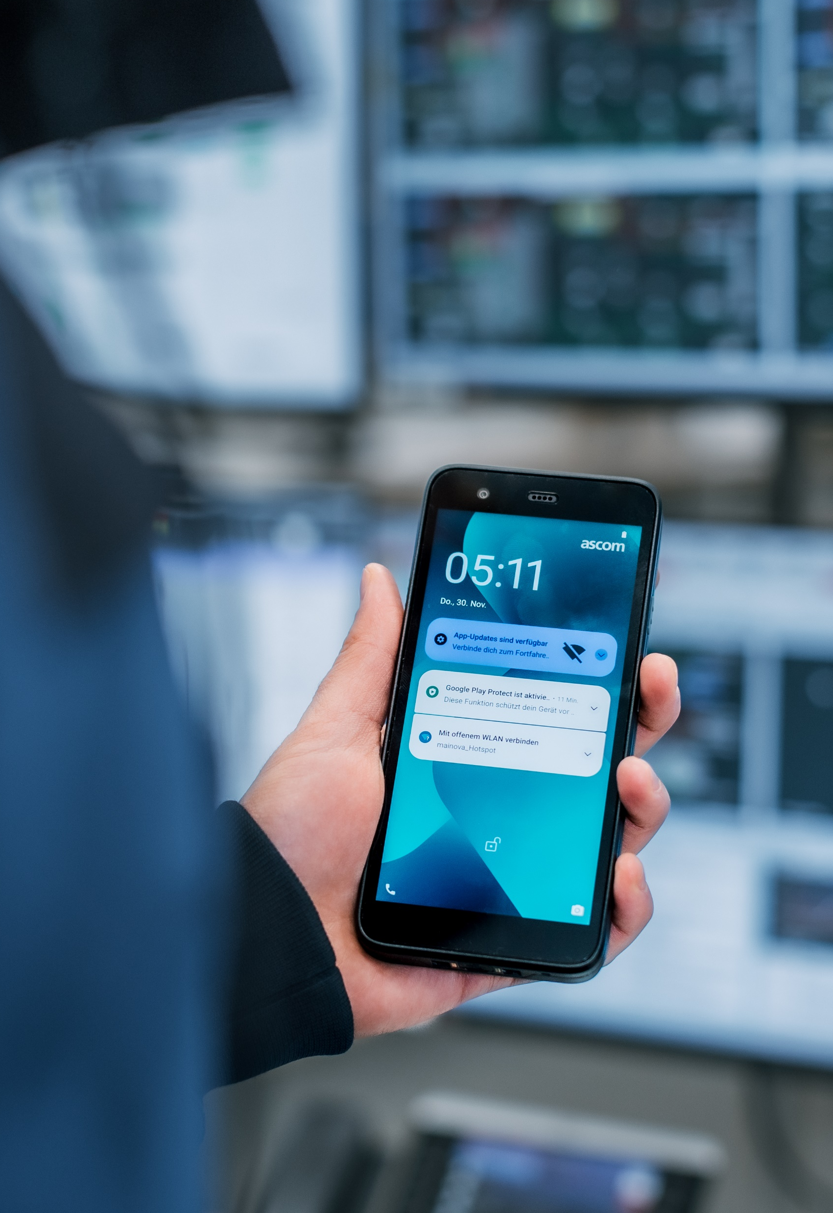
TCO – Ascom Myco 4 vs. Standard smartphone
Example with 100 users
 | Ascom Myco 4 | Standard smartphone | Comments
Administrative costs | Replacement and configuration of a few spare devices and 300 batteries. | Replacement and configuration of 360-480 devices. | Big difference in admin cost.
Support | Ascom can support with configuration in EMM and use our experience for a successful implementation. Wi-Fi interop. | The customer has to manage and configure the device in EMM. Ascom will provide an app for the device. | Android Enterprise Recommended -> Extended security updates. Limit no. of suppliers.
Extra functionality | Alarm button, function buttons, top LED, clip, barcode scanner, professional chargers, cleaning and disinfection. |  | See separate presentation of Ascom Myco 4.
Configuration in a medical device environment. | Minimum volume, supervision of Ascom apps, repeat battery warning, lockdown of home screen.

